Slide 1
THỰC HÀNH: PHÂN TÍCH XQUANG NGỰC
THS. BS. NGÔ NGUYỄN HẢI THANH
Bm. Nội Tổng quát, Đại học y dược tphcm.

Slide 2

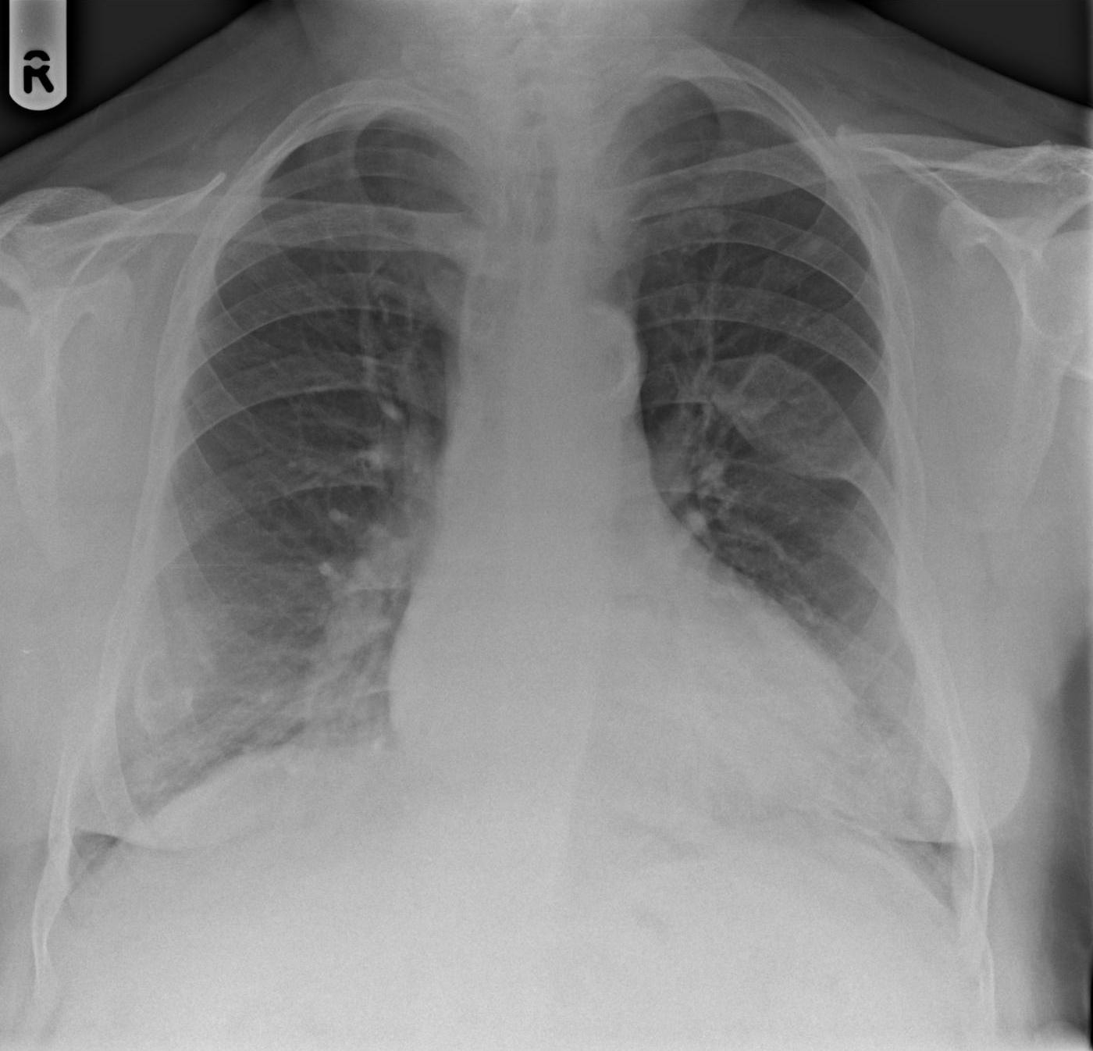
QUIZ # 01 38 year-old-female with chronic renal failure due to polycystic kidney disease. Blood biochemistry revealed hypocalcaemia, hyperphosphataemia and elevated parathyroid hormone levels; What is the most likely diagnosis?
A. Enchondromas
B. Fibrous dysplasia
C. Aneurysmal bone cysts
D. Brown tumours
E. Simple bone cysts
Notes:
D. Brown Tumours. There are multiple lucent bone lesions. There is an expansile lytic lesion centred on the left 7th rib. In addition, there are lucencies in the lateral aspect of the right 9th rib and the anterior aspect of the right 7th rib. Given the clinical history, the findings are most in keeping with Brown tumours. However, similar appearances can also be seen with metastases (thyroid and renal metastases can produce expansile lytic metastases) as well as multiple myeloma.

Slide 3
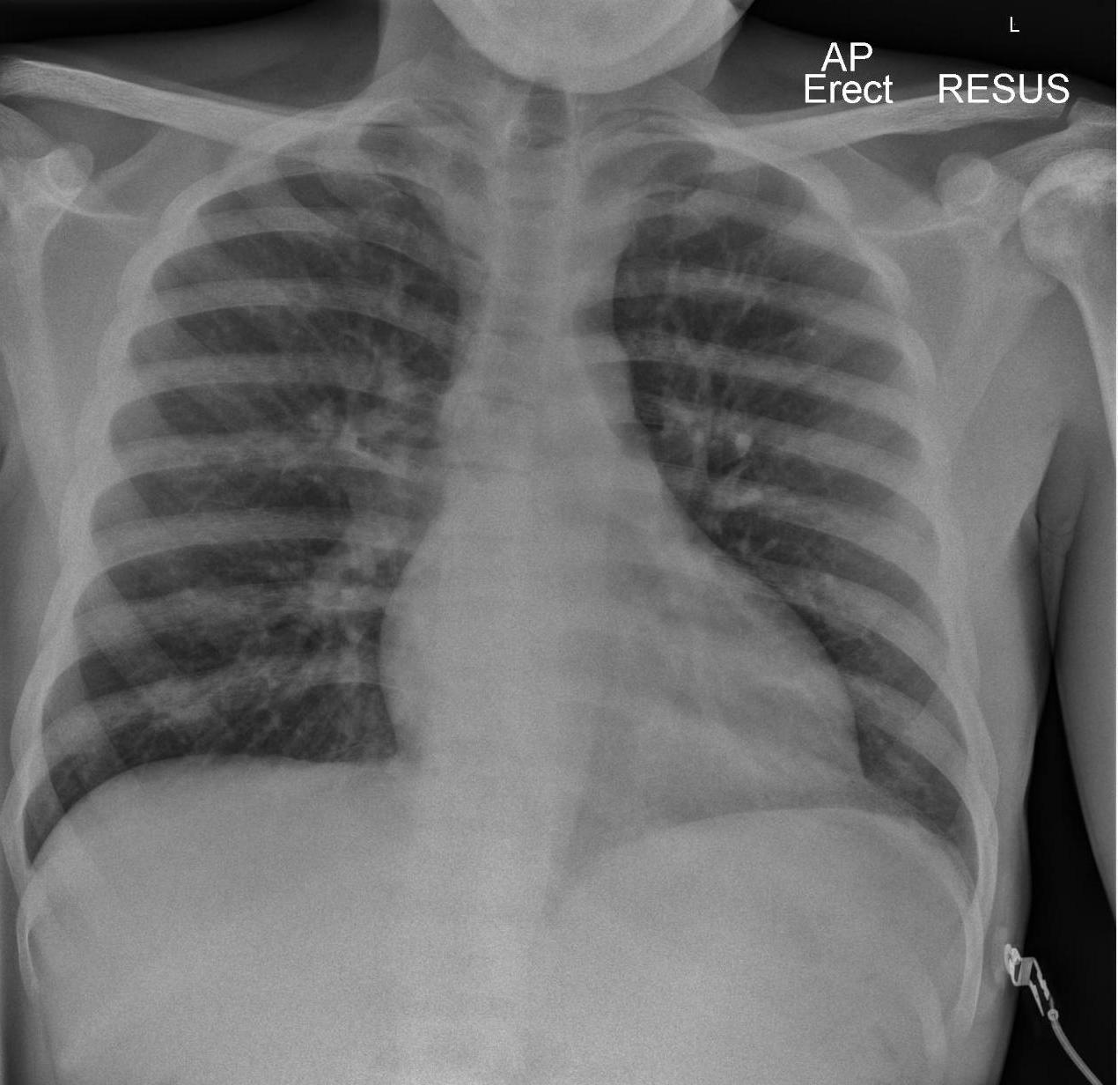
QUIZ # 02 34 year-old-male presenting with chest pain: What is the main abnormality?
A. Normal appearances
B. Lung parenchymal abnormality
C. Mediastinal abnormality
D. Hilar abnormality
E. Bony abnormality
Notes:
E. Bony abnormality. The bones are sclerotic due a generalised increase in bone density. There is also altered bone density within the left humeral head due to avascular necrosis. This patient has sickle cell disease.
Avascular necrosis (subchondral osteonecrosis) refers to ischaemic death of the constituents of bone. On plain radiographs, there is initial minor osteopaenia, followed by variable density. Gradually microfractures accumulate in the dead bone, which unable to repair leading to collapse of the articular surface and the so called ‘crescent sign’. Subsequently, the cortex collapses and there is fragmentation.

Slide 4
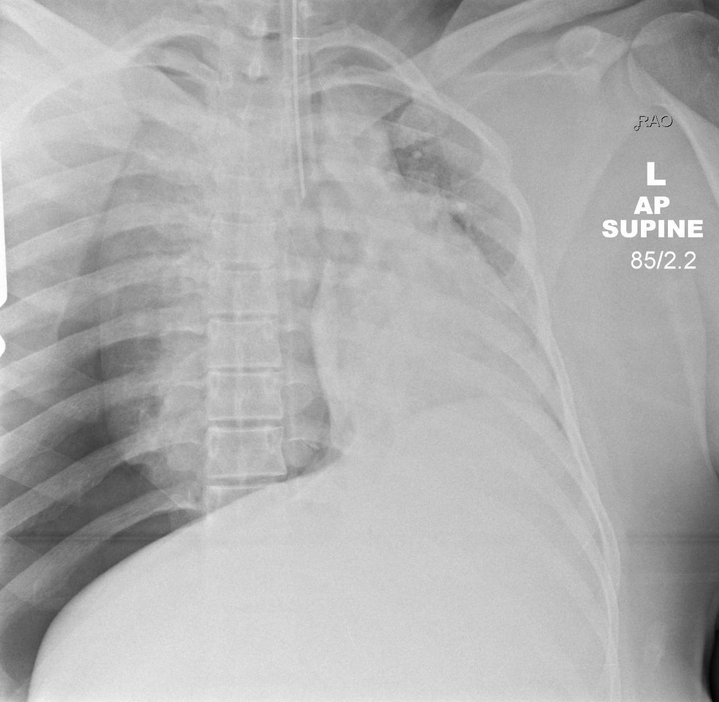
QUIZ # 03 32 year-old-pregnant female involved in a road traffic accident;
1. What is the main abnormality?
A. Left lobar collapse
B. Right lobar collapse
C. Technically inadequate film which needs to be repeated urgently
D. Tension Pneumothorax
E. Diaphragmatic injury
2. Is the endotracheal tube in a satisfactory position?
A. Yes
B. No
Notes:
1. D. Tension Pneumothorax. There is a right sided pneumothorax with radiological evidence of tension. There is significant venous return to the heart. Collapse of the right lung is also present. Urgent decompression is required in the first instance.
2. B. No. The endotracheal tube is not in a satisfactory position and is located at the carina. It needs to be repositioned.

Slide 5
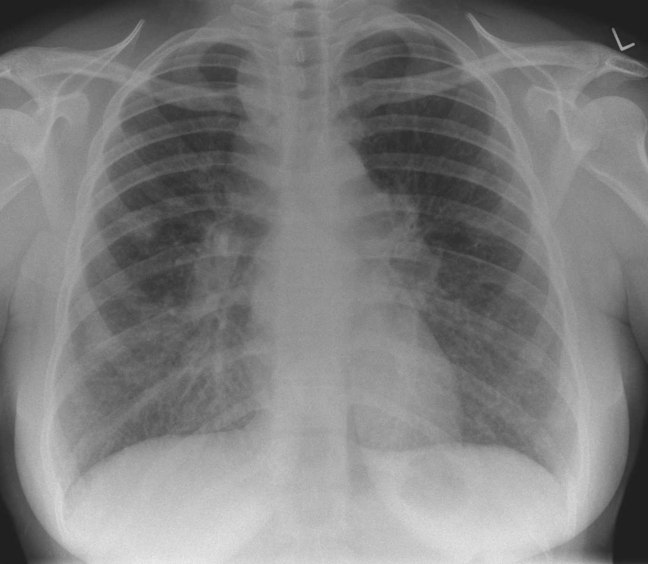
QUIZ # 04 33 year-old-female presenting with fevers, dry cough and erythema nodosum; What is the most likely diagnosis?
A. Tuberculosis
B. Lymphoma
C. Metastatic Bronchogenic carcinoma
D. Sarcoidosis
E. Metastatic breast carcinoma
Notes:
D. Sarcoidosis. There is widespread lymphadenopathy involving the right paratracheal nodes, aortopulmonary window and bilateral hila regions. There is nodular opacification within both mid and lower zones as well as two confluent areas of opacification within the right midzone. The most likely diagnosis is sarcoidosis. The 1-2-3 sign or Garland triad is the classic pattern of lymphadenopathy seen in sarcoidosis and refers to bilateral hilar lymphadenopathy and right paratracheal nodal enlargement.

Slide 6
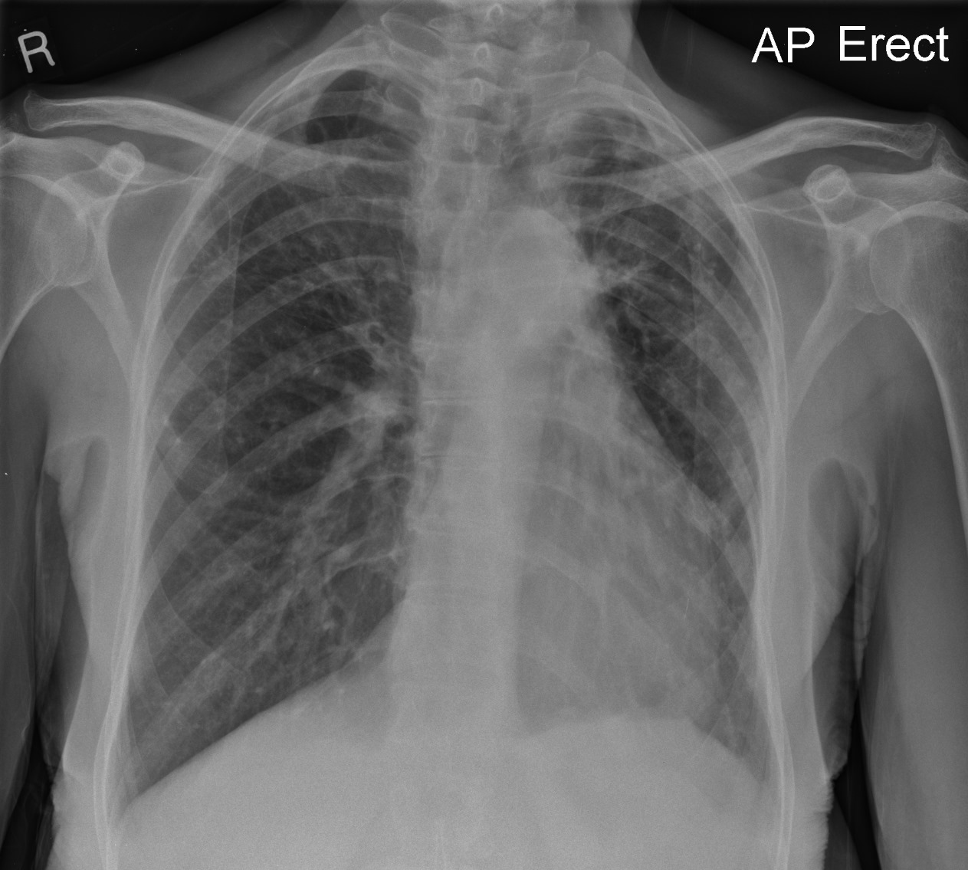
QUIZ # 05 52 year-old-male presenting with acute confusion; What is the main abnormality?
A. Lobar collapse
B. Miliary nodules
C. Pulmonary fibrosis
D. Paravertebral abnormality
E. Normal appearances
Notes:
C. Pulmonary fibrosis. There is reticular shadowing within both upper zones with associated volume loss – note the elevated position of both hila. The findings are in keeping with bilateral upper lobe fibrosis. The patient had a previous history of tuberculosis - note the two calcified granulomata within the left upper zone.

Slide 7
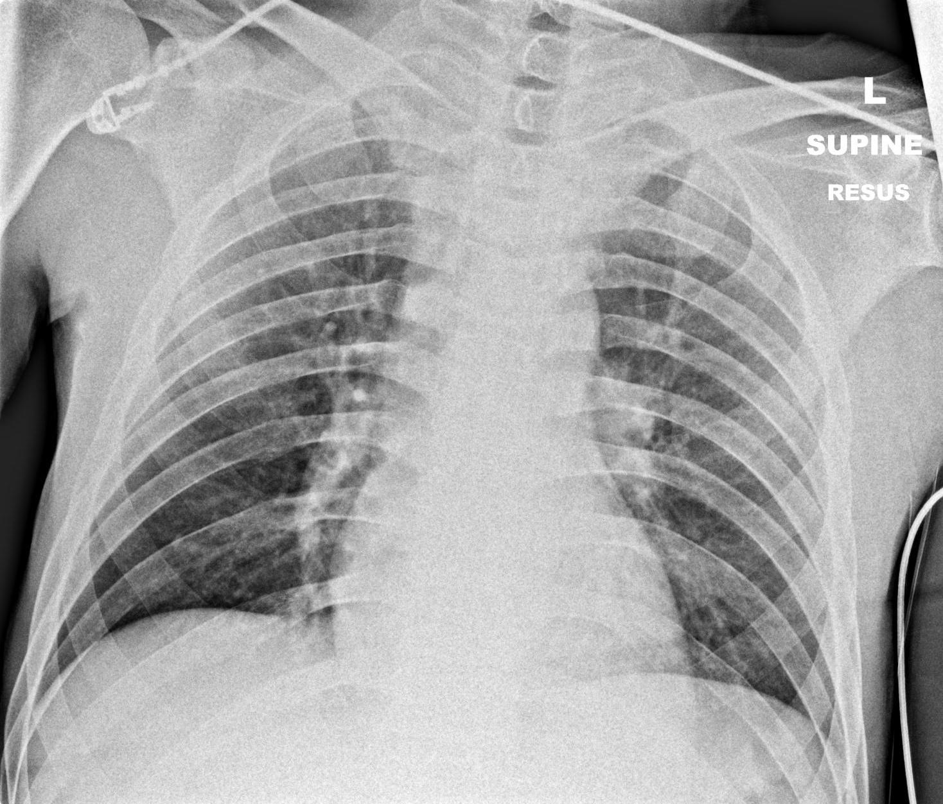
QUIZ # 06 33 year-old-male admitted following a stab injury to the torso; What is the main abnormality?
A. Normal appearances
B. Consolidation
C. Haemothorax
D. Traumatic bony injury
E. Pneumothorax
Notes:
A. Normal appearances. No significant abnormality.

Slide 8
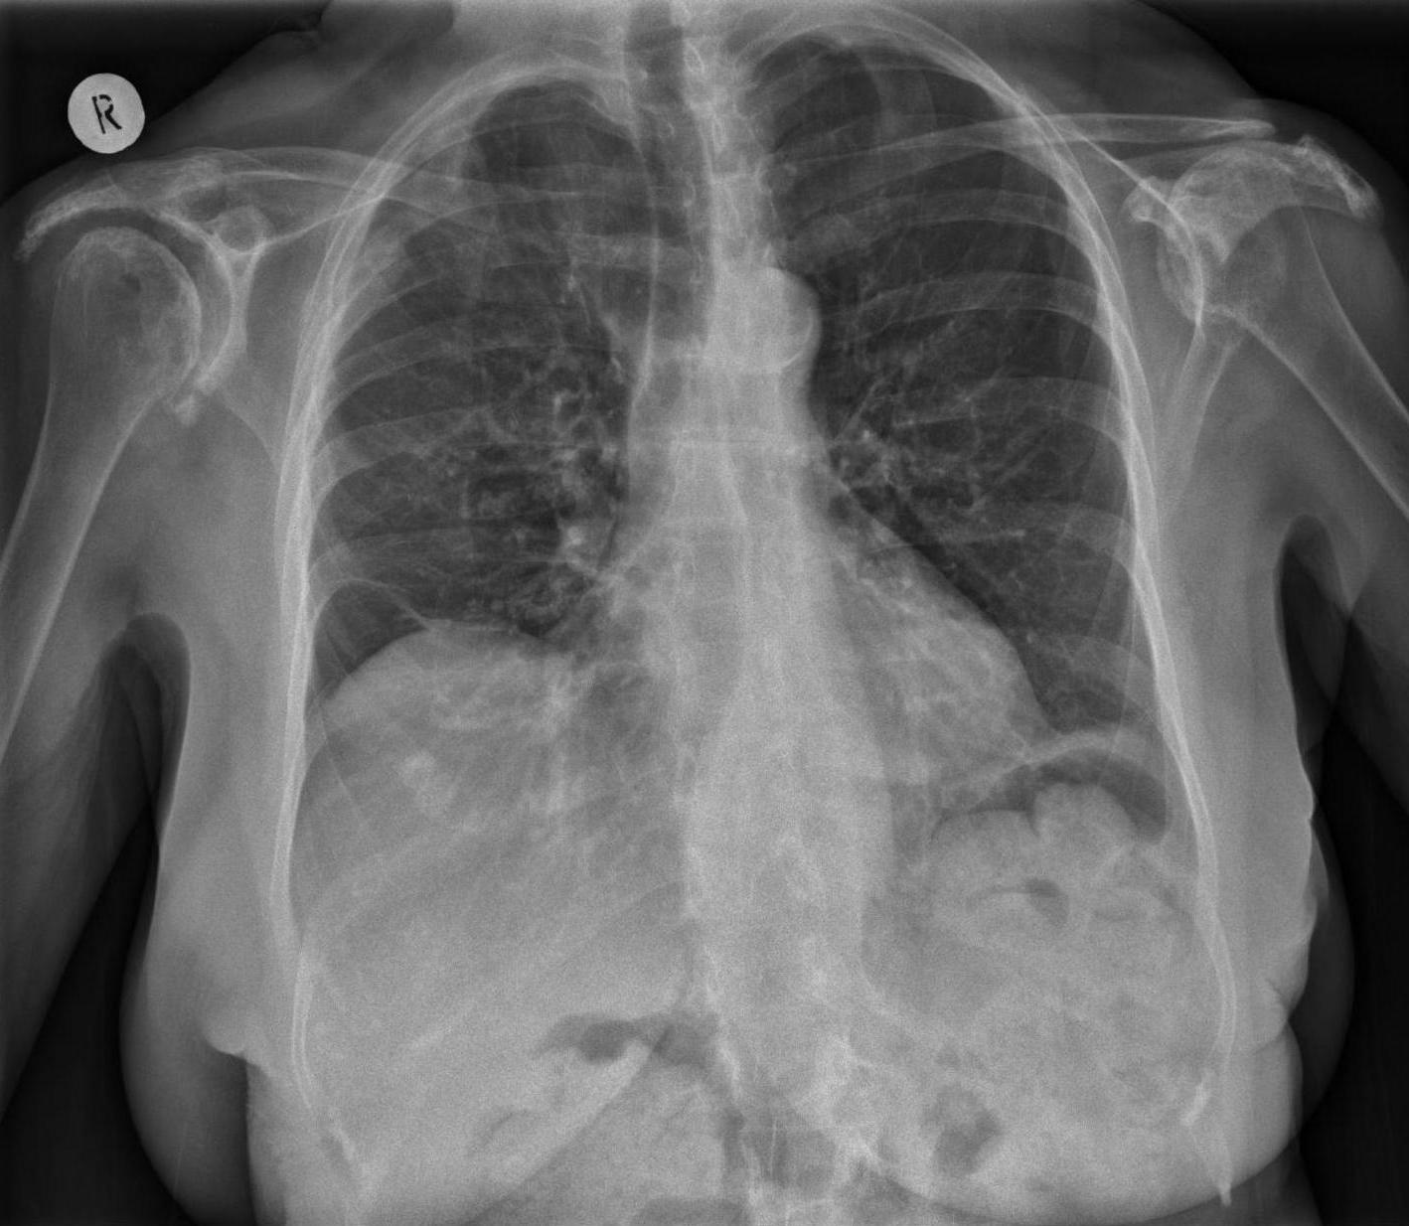
QUIZ # 07 43 year-old-female presenting with cough and shortness of breath; What is the main abnormality?
A. Bony abnormality
B. Pulmonary fibrosis
C. Paravertebral abnormality
D. Mediastinal abnormality
E. Pleural abnormality
Notes:
A. Bony abnormality. There are erosive changes at the distal end of the left clavicle. In addition, there is a ‘high riding’ humeral head on the left side. The patient had a longstanding history of rheumatoid arthritis. (There is also an old healing right sided fourth rib fracture)

Slide 9
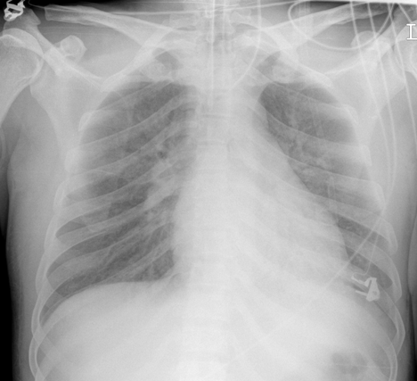
QUIZ # 08 32 year-old-male presenting with fevers and productive cough. Transferred to ITU with worsening sepsis;
1. What is the main abnormality?
A. Pleural effusion
B. Pneumothorax
C. Mediastinal abnormality
D. Consolidation
E. Normal appearances
2. Is the endotracheal tube appropriately positioned?
A. Yes
B. No
1. What is the main abnormality?
A. Pleural effusion
B. Pneumothorax
C. Mediastinal abnormality
D. Consolidation
E. Normal appearances
2. Is the endotracheal tube appropriately positioned?
A. Yes
B. No
Notes:
1. D. Consolidation. The left hemi-diaphragm cannot be visualised and given the clinical history of sepsis the findings are likely due to left lower lobe consolidation. The dome of the diaphragm should be well defined bilaterally; in this case the right hemi-diaphragm is well visualised (yellow line) whereas the left is not (broken yellow line);
2. Yes - The endotracheal tube is appropriately positioned. The central line is within the left brachiocephalic vein and could be advanced further.

Slide 10
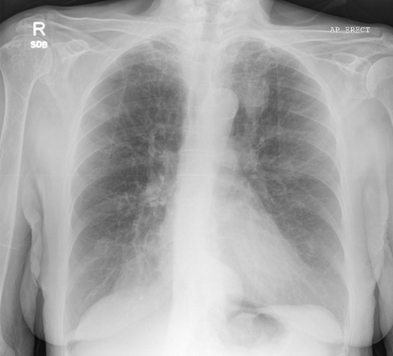
QUIZ # 09 54 year-old-female with fatigue and weight loss with a known hiatus hernia; What is the main abnormality?
A. No significant abnormality
B. Pleural abnormality
C. Bony abnormality
D. Mediastinal abnormality
E. Soft tissue mass
Notes:
E. There is a soft tissue mass noted in the left upper zone. This was due to a squamous cell carcinoma of the lung following tissue biopsy. There is a soft tissue opacity in the retrocardiac region which was in keeping with the patients known hiatus hernia.

Slide 11
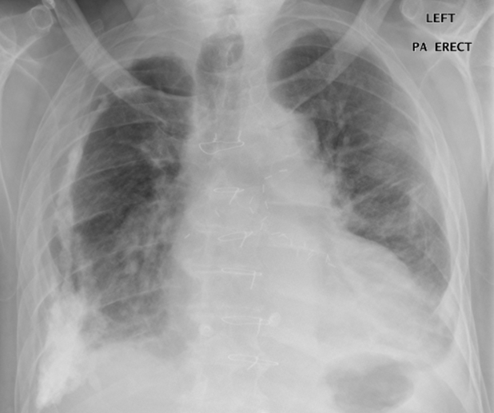
QUIZ # 10 54 year-old-male with breathless at rest, weight loss and right sided chest pain; Given the clinical history what is your main concern?
A. Pleural fibroma
B. Asbestosis
C. Mesothelioma
D. Pleural adenocarcinoma
E. Cardiac failure
Notes:
C. Mesothelioma. There is a right sided calcified pleural plaque in a patient with previous exposure to asbestos. However, also note the diffuse pleural thickening (yellow arrows) within the right hemithorax. Given the clinical history the main concern would be regarding the development of a malignant mesothelioma.

Slide 12
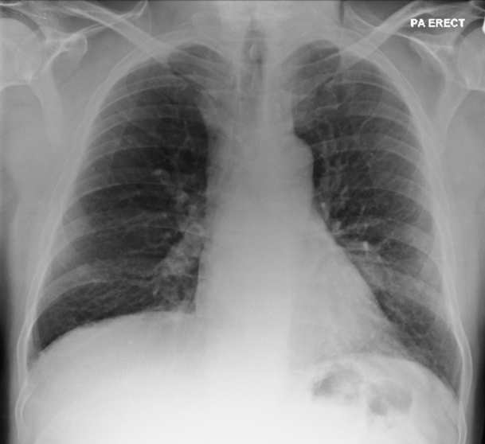
QUIZ # 11 44 year-old-male with a history of chronic cough presenting with new onset of fevers. What is the main abnormality?
A. Pulmonary fibrosis
B. Hilar adenopathy
C. Pulmonary consolidation
D. Normal appearances
E. Bronchiectasis
Notes:
E. Bronchiectasis. There are thickened and dilated airways (yellow arrows) in keeping with bronchiectasis. Bronchiectasis refers to the permanent dilation of bronchi with destruction of the elastic and muscular components of their walls, usually due to acute or chronic infection. In addition there is an area of opacification adjacent to the left heart border which was due to an area of consolidation within the left lower lobe (red arrow). This accounted for the acute deterioration and resolved on follow up imaging.

Slide 13
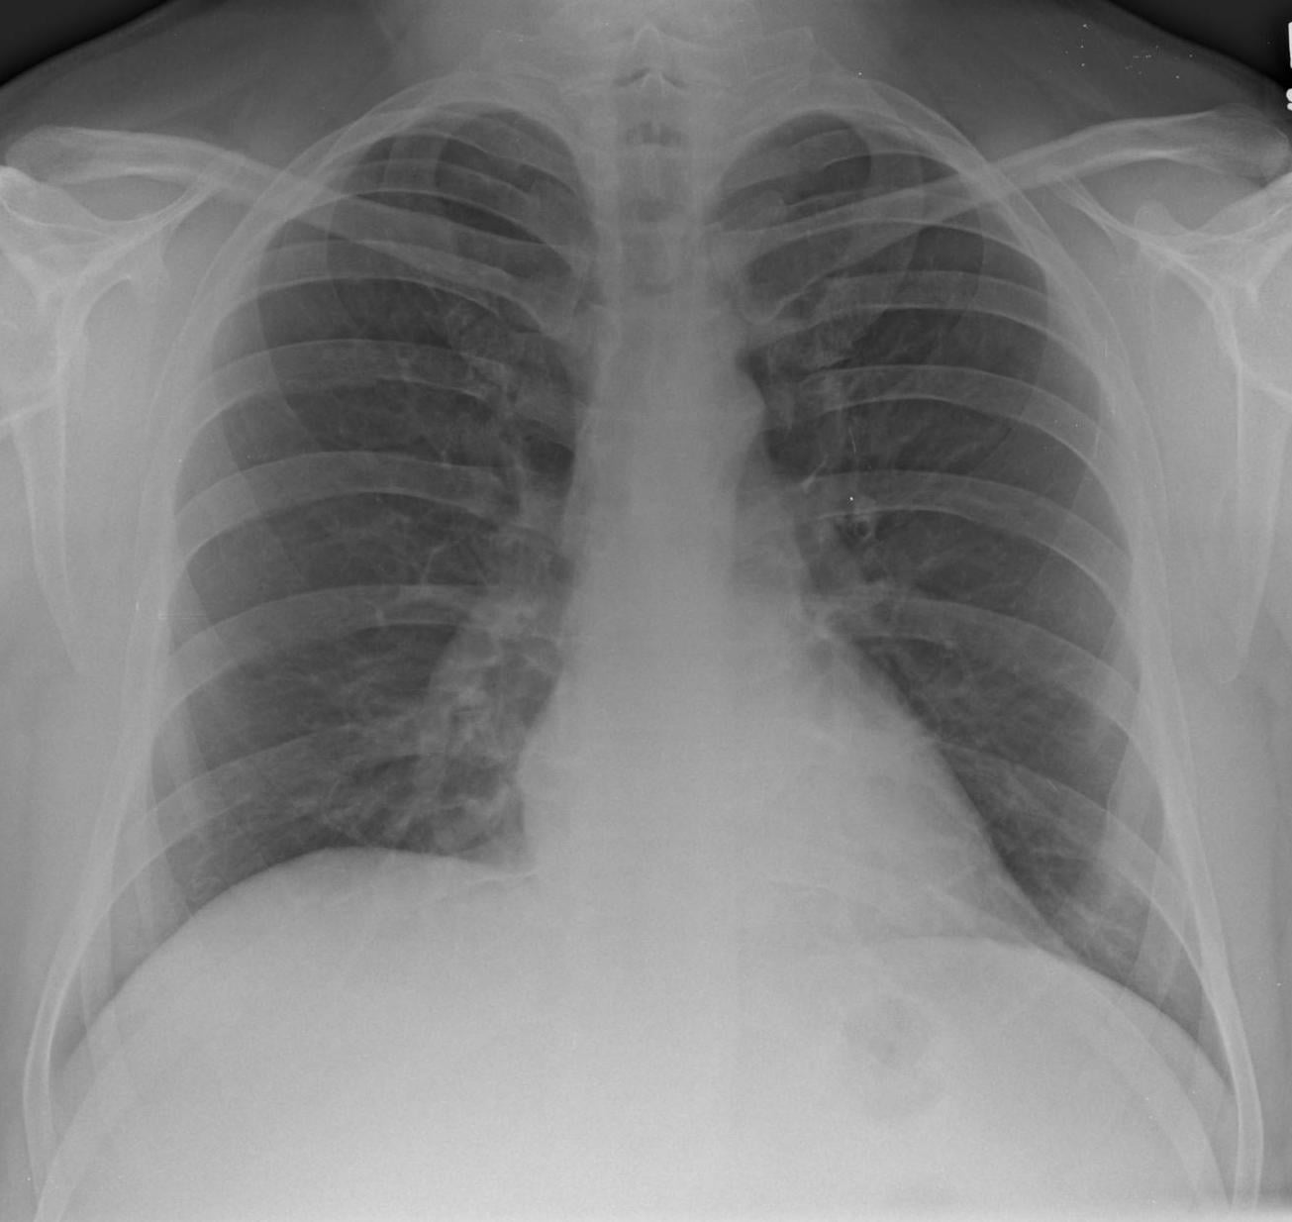
QUIZ # 12 53 year-old-male with acute confusion; What is the main abnormality?
A. Lung parenchymal abnormality
B. Bony abnormality
C. Normal appearances
D. Pleural abnormality
E. Mediastinal abnormality
Notes:
C

Slide 14
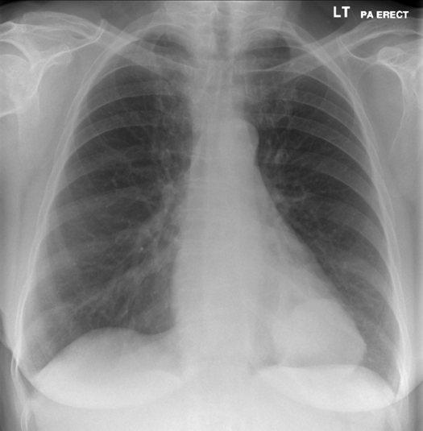
QUIZ # 13 41 year-old-female admitted with sepsis of unknown source. What is the main abnormality?
A. Breast tissue asymmetry
B. Bony abnormality
C. Mediastinal abnormality
D. Pleural abnormality
E. Soft tissue mass
Notes:
E

Slide 15
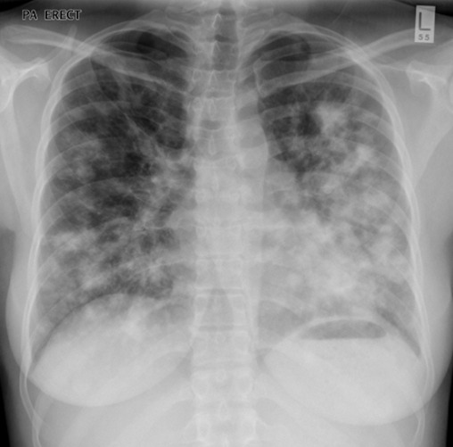
QUIZ # 14 35-year-old patient with HIV with a CD4 count of 125 cells /mm3. Which of the following is the most likely diagnosis given these appearances and clinical history?
A. PCP pneumonia
B. Kaposi’s sarcoma
C. Sarcoidosis
D. Tuberculosis
E. Hodgkin’s lymphoma
Notes:
B. Kaposi’s sarcoma. There are multiple ill defined (‘fluffy’) nodular opacities throughout both mid and lower zones. Given the clinical history the most likely diagnosis is Kaposi sarcoma which represents a low-intermediate grade mesenchymal tumour that involves the lymphovascular system. Histologically can comprise of sheets of plump spindle shaped cells surrounding and lining slit like vascular spaces. It is an AIDS defining malignancy that is usually seen in patients with a CD4 count below 200 cells /mm3. The tumour can involve multiple organs including pulmonary, gastrointestinal, cutaneous and musculoskeletal systems.
On a chest radiograph, Kaposi Sarcoma can present as;
Parenchymal nodular opacities (as in this case)
Reticular pattern with linear interstitial nodules
Lymph node enlargement
Pleural effusion (unilateral/bilateral)
The differential to consider would include AIDS related lymphoma or atypical infections (e.g. fungi, mycobacteria, Pneumocytis jiroveci).

Slide 16
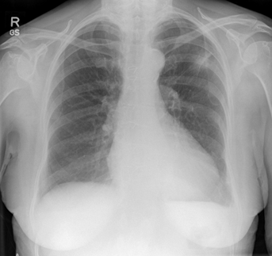
QUIZ # 15 58 year-old-female with a history of high alcohol intake presenting with haematemesis. What is the main abnormality?
A. Mediastinal abnormality
B. Pulmonary consolidation
C. Soft tissue mass
D. Pulmonary fibrosis
E. Pleural abnormality
Notes:
C. Soft tissue mass. There is a soft tissue mass in the left upper zone which was confirmed to be a squamous cell carcinoma following CT guided biopsy.
There is blunting of the left costophrenic angle which was confirmed to be due to a pleural fluid collection on the staging CT scan. There are also sternotomy wires present from a previous coronary artery bypass graft operation.

Slide 17
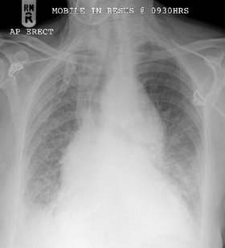
QUIZ # 16 88 year-old-female with chest pain and diastolic murmur; What is the main abnormality?
A. Lung parenchymal abnormality
B. Aortic abnormality
C. Hilar abnormality
D. Technical factors due to patient rotation
E. Unfolded thoracic aorta due to ageing
Notes:
B. Aortic abnormality. The aortic arch is enlarged which accounts for the soft tissue density that is causing tracheal deviation.
There is blunting of both costophrenic angles likely due to bilateral pleural effusions and there is also widespread reticular shadowing (the septal lines are difficult to appreciate due to the quality of the image) due to cardiogenic pulmonary oedema.
In this case, the patient had a longstanding aneurysm of the aortic arch with associated aortic regurgitation (hence the diastolic murmur). The patient had a longstanding history of rheumatoid arthritis and the aneurysm was attributed to the patients’ connective tissue disorder. The differential for these appearances would include;
Atherosclerosis
Cystic medial necrosis (Marfan’s disease)
Mycotic aneurysm
Syphilis (tertiary stage)
Trauma
Congenital

Slide 18
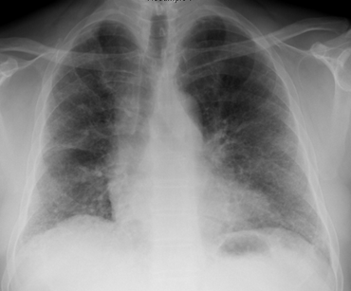
QUIZ # 17 44 year-old-male with dry cough and breathlessness; What is the main abnormality?
A. Interstitial shadowing
B. Bronchiectasis
C. Mediastinal abnormality
D. Vascular abnormality
E. Normal appearances
Notes:
A. Interstitial shadowing. There is interstitial/reticular shadowing noted predominantly in a basal and subpleural distribution in keeping with lung fibrosis (see selected HRCT image which confirms the predominantly subpleural distribution of the fibrotic process)
There is a wide differential diagnosis for these appearances, which includes;
IDIOPATHIC:
- Usual interstitial pneumonia/Cryptogenic fibrosing alveolitis
C/TISSUE DISORDERS:
- Rheumatoid arthritis
- Scleroderma
DRUGS:
- Methotrexate / Amiodarone / Nitrofurantoin / Busulphan / Bleomycin
INORGANIC DUSTS:
- Asbestosis
- Silicosis

Slide 19
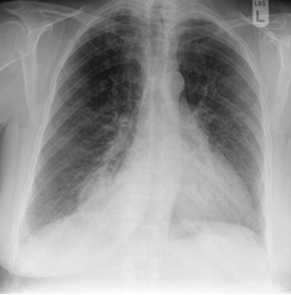
QUIZ # 18 57 year-old-female presenting with chest pain and haemoptysis; What is the main abnormality?
A. Soft tissue mass and further cross-sectional imaging is advised
B. Pleural fluid collection and ultrasound is advised
C. Lobar collapse and endoscopy is advised
D. Pulmonary consolidation and a repeat chest radiograph is advised
E. Mulitple bony abnormalities and radioisotope bone scan is advised
Notes:
A. Soft tissue mass and further cross-sectional imaging is advised. There is a soft tissue mass projected adjacent to the right heart border suspicious for a primary bronchogenic carcinoma. The presence of a mass was confirmed on the subsequent CT scan (red arrow)
An axial contrast enhanced CT of the chest and upper abdomen would be advised for further assessment.

Slide 20
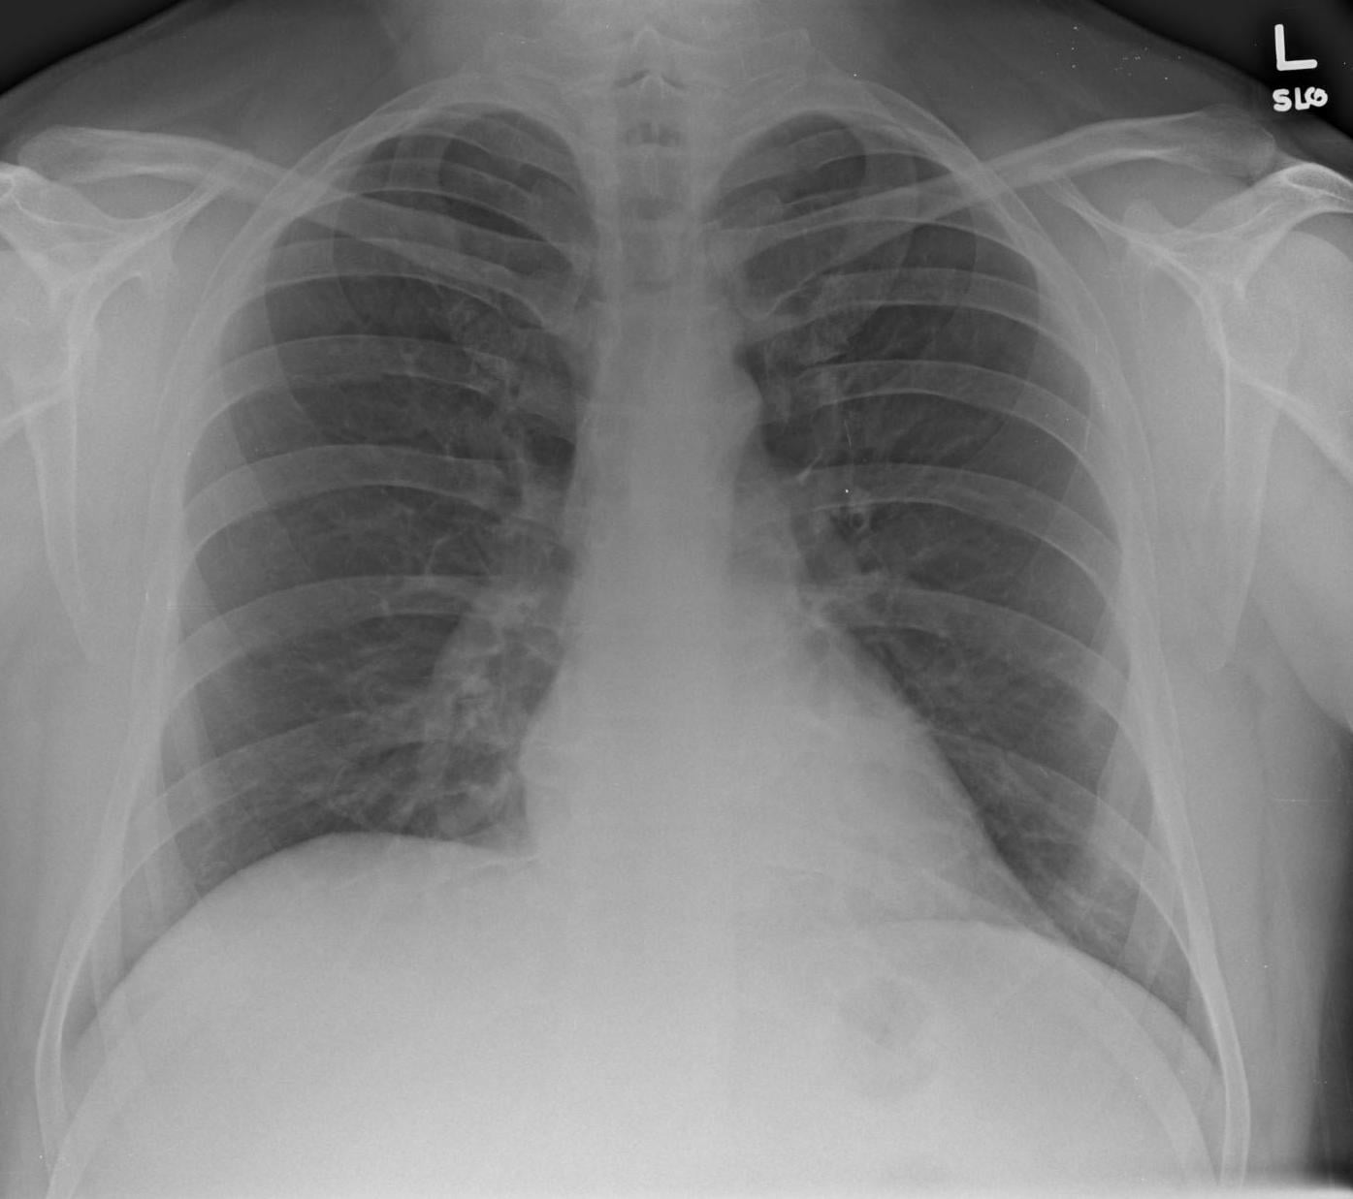
QUIZ # 19 42 year-old-presenting with left sided chest pain and shortness of breath; What is the main abnormality?
A. Lung parenchymal abnormality
B. Mediastinal abnormality
C. Bony abnormality
D. Pulmonary vasculature abnormality
E. Normal appearances
Notes:
E

Slide 21
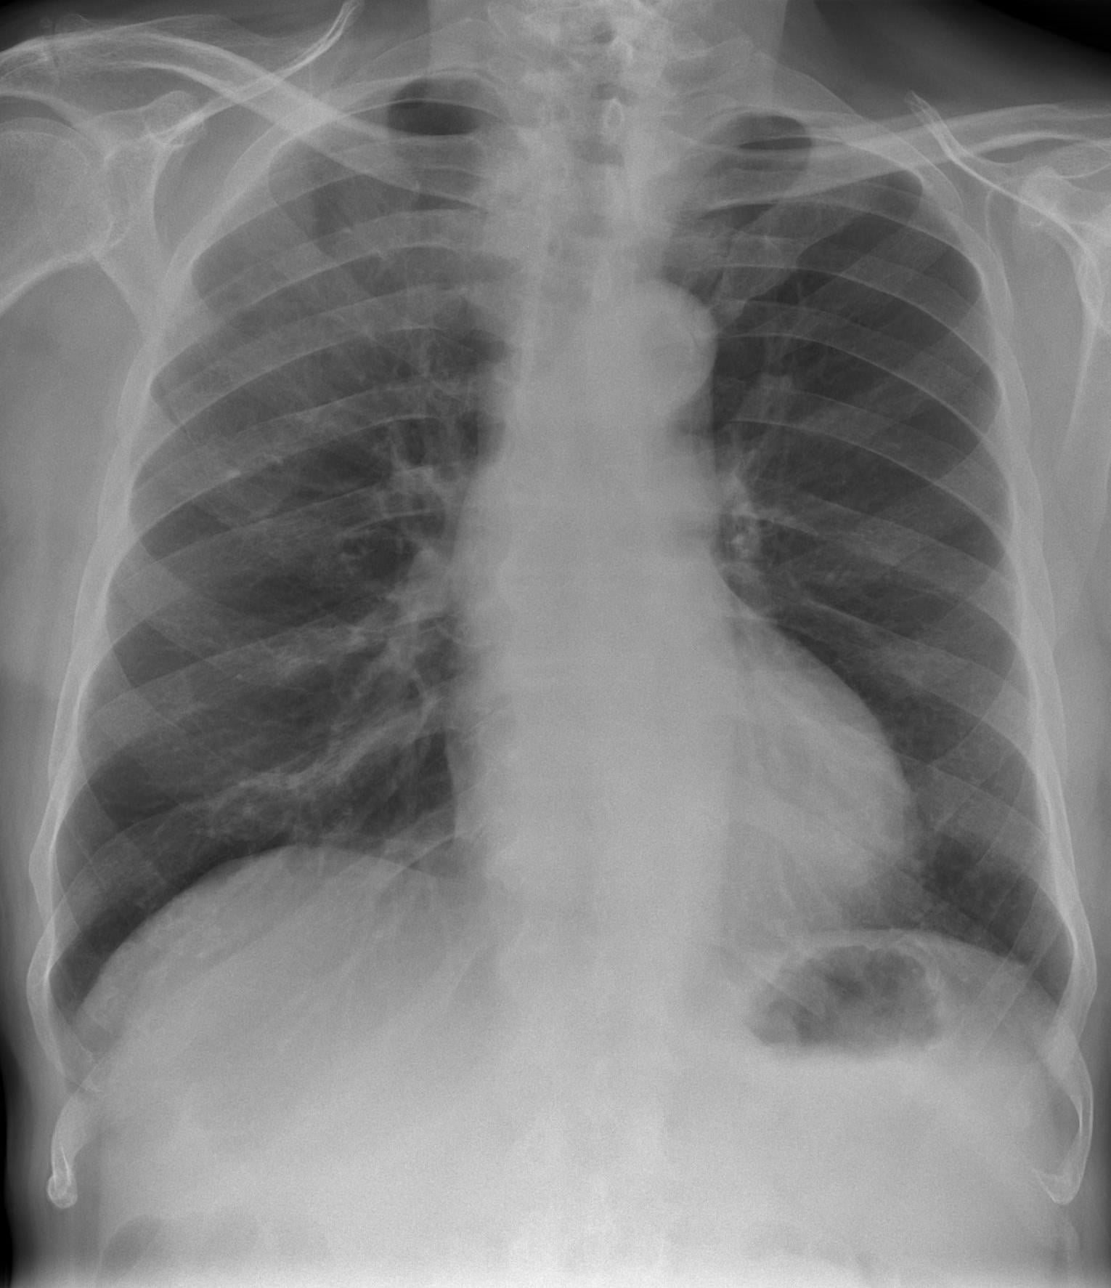
QUIZ # 20 34 year-old-male with productive cough and pleurisy; What is the main abnormality?
A. Normal appearances
B. Perihilar bronchial wall thickening
C. Tracheal abnormality
D. Mediastinal abnormality
E. Consolidation
Notes:
E. Consolidation. There is consolidation within the right upper zone.

Slide 22
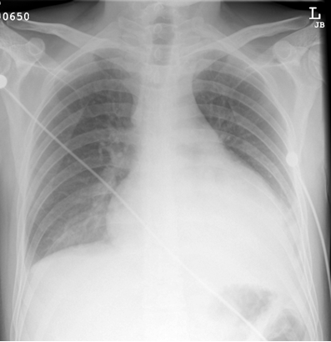
QUIZ # 21 35 year-old-male with chronic diarrhea and weight loss; What is the main abnormality?
A. Bilateral pleural effusions
B. Mediastinal abnormality
C. Cardiomegaly and pleural effusions
D. Left atrial enlargement
E. Left ventricular aneursym
Notes:
C. Cardiomegaly and pleural effusions.
The cardiac contour is significantly enlarged and there is blunting of both costophrenic angles. This correlates with the pericardial effusion and the bilateral pleural fluid collections identified on the subsequent CT.
The patient had a low albumin level due to a protein losing enteropathy. This was confirmed from a pleural tap which noted the presence of a transudative pleural effusion.

Slide 23
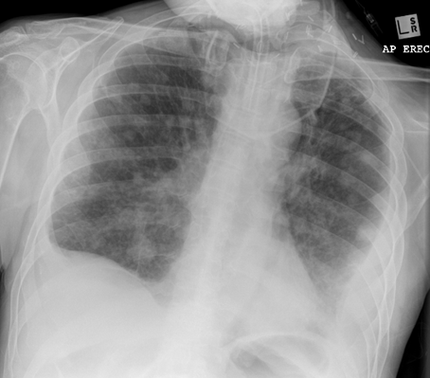
QUIZ # 22 1. Which of the following is not evident on the chest radiograph? A. Evidence of previous surgery B. Malpositioned tracheostomy C. Mulitple pulmonary nodules D. Bilateral pleural effusions E. Normal heart size 2. What is the most likely cause for these appearances? A. Wegener’s granulomatosis B. Parathyroid hyperplasia C. Metastatic laryngeal carcinoma D. Sarcoidosis E. Hereditary haemorrhagic telangiectasia
Notes:
1. B. Malpositioned tracheostomy.
There are multiple soft tissue opacities throughout both lungs, and there are bilateral pleural fluid collections (larger on the left).
There are also multiple surgical clips within the soft tissues of the neck and there is a tracheostomy in situ which is appropriately positioned. This patient had been treated for laryngeal carcinoma in the past which had recurred with widespread metastases.
2. C. Metastatic laryngeal carcinoma. The most likely cause for these multiple soft tissue opacities is metastases. The clue to the potential primary is the presence of previous neck surgery.

Slide 24
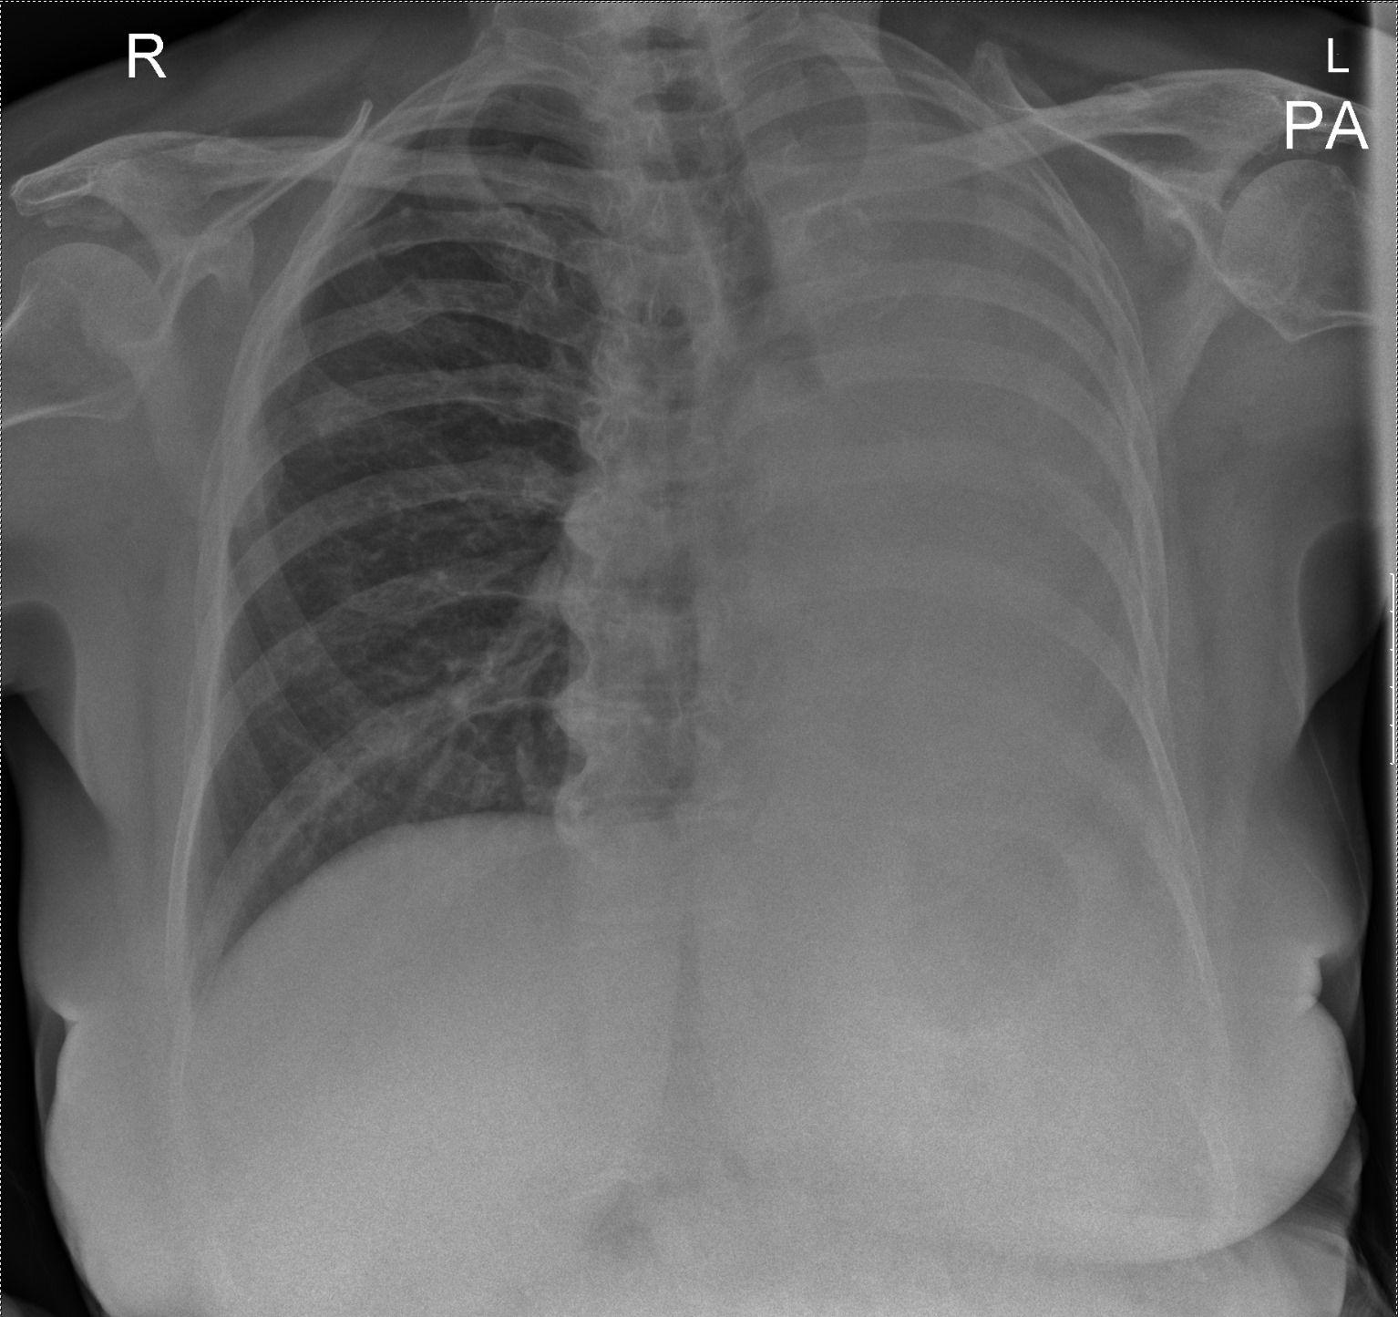
QUIZ # 23 61-year-old female with shortness of breath at rest; What is the main abnormality?
A. Lobar collapse
B. Pleural effusion
C. Pneumonectomy
D. Bronchopleural fistula
E. Pulmonary consolidation and cavitation
Notes:
A. Lobar collapse. Complete opacification of the left hemithorax with associated volume loss and both tracheal and mediastinal shift towards the affected side. This was due to total collapse of the left lung due to an obstructing bronchial carcinoma. Note the tapering of the right main bronchus. The appearances could be secondary to a pneumonectomy but there are no surgical sutures evident and rib abnormalities.
There are healing right sided rib fractures involving ribs 3-8 with callus formation. There is also calcification noted in the region of the right supraspinatus tendon.

Slide 25
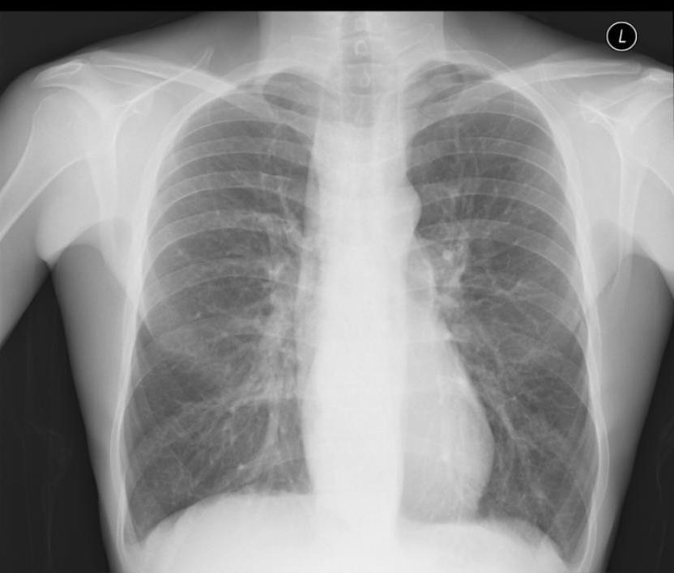
QUIZ # 24 34-year-old male with nausea and chest discomfort; What is the main abnormality?
A. Mediastinal abnormality
B. Hilar abnormality
C. Bony abnormality
D. Pleural abnormality
E. Normal appearances
Notes:
A. Mediastinal abnormality. There is a dilated gas filled viscus within the mediastinum which was confirmed to be due to an achalasia. Note the absence of the gastric stomach bubble as well.

Slide 26
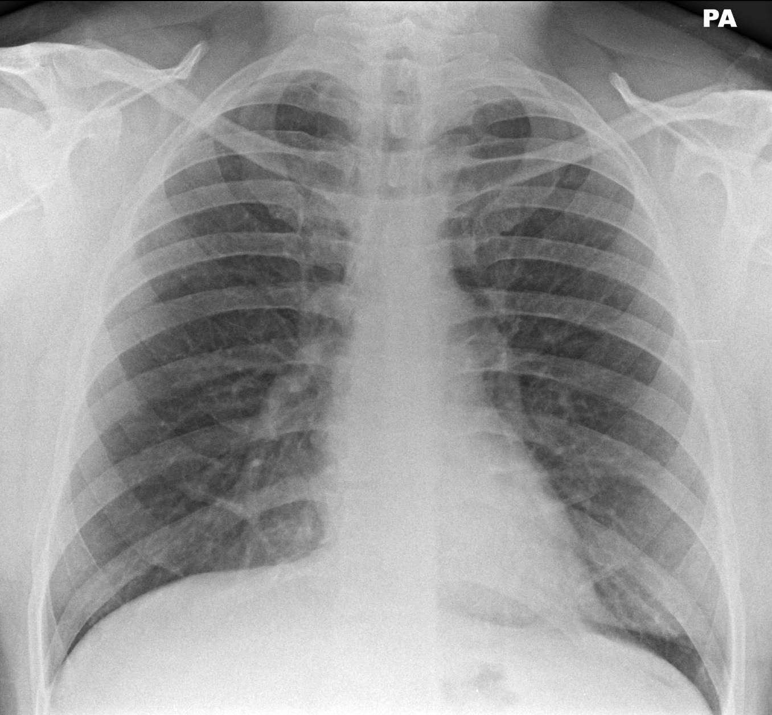
QUIZ # 25 42-year-old male with pleuritic chest pain; What is the main abnormality?
A. Hilum abnormality
B. Lung parenchymal abnormality
C. Pleural abnormality
D. Cardiac outline abnormality
E. Normal appearances
Notes:
E. Normal appearances. There is no significant abnormality identified on the chest radiograph. In this case the pain resolved without a definitive diagnosis being made.

Slide 27
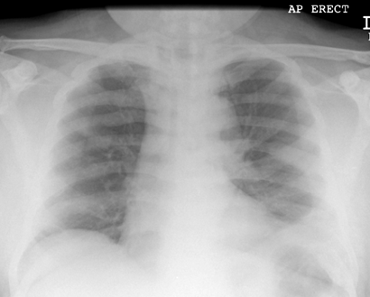
QUIZ # 26 67-year-old male presenting with weight loss and back pain; What is the main abnormality?
A. Lung parenchymal abnormality
B. Vascular abnormality
C. Bony abnormality
D. Soft tissue abnormality
E. Airway abnormality
Notes:
C. Bony abnormality. The bones are generally sclerotic with multiple expansile rib lesions. The patient was diagnosed with metastatic prostate cancer.
The differential diagnosis for generalised increase in bone density includes;
METABOLIC
- Renal osteodystrophy
- Paget’s disease
NEOPLASIA
- Metastases (Prostate, Breast carcinoma)
- Lymphoma
MYELOPROLIFERATVE
- Myelofibrosis
OTHER
- Fluorosis
- Mastocytosis

Slide 28
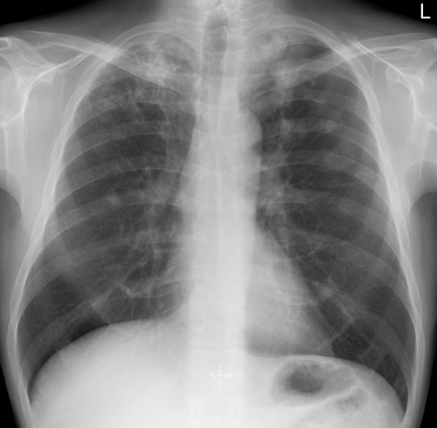
QUIZ # 27 32-year-old male intravenous drug user admitted with ongoing fevers, productive cough and feeling generally unwell;
1. What are the main abnormalities?
A. Lung parenchymal abnormalities with lymphadenopathy
B. Lung parenchymal abnormalities and a paravertebral collection
C. Lung parenchymal abnormalities with possible cavitation and bony lesions
D. Lung parenchymal abnormalities with possible cavitation
E. Lung parenchymal abnormalities with loculated pleural fluid collection
2. Given the clinical history, what is the most likely cause for these appearances?
A. Pulmonary emboli
B. Septic emboli
C. Metastatic disease
D. Wegener’s granulomatosis
E. Hypersensitivity pneumonitis
Notes:
1) D. The main abnormalities include the multifocal airspace opacification within both upper and both midzones (yellow arrows).
Area of consolidation within the right upper zone with evidence of air bronchograms (red arrow).
The focal area of opacification at the right apex contains a small lucent area raising the possibility of cavity formation (blue arrow).
2) B. The most likely cause for these appearances would be an infective process – this patient developed septic emboli due to Staphylococcus aureus. The patient also had a previous history of tuberculosis infection.

Slide 29
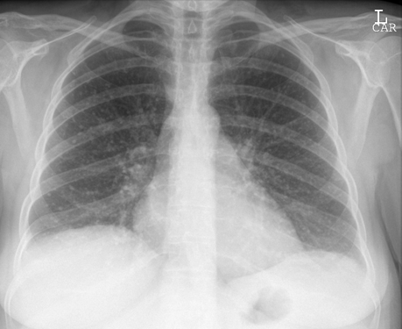
QUIZ # 28 31-year-old asymptomatic female presenting for occupational heath screening; What is the most likely explanation for these findings?
A. Miliary tuberculosis
B. Renal carcinoma metastases
C. Alveolar proteinosis
D. Previous varicella pneumonia
E. Non hodgkins lymphoma
Notes:
D. Previous varicella pneumonia. There are multiple small calcific nodules scattered throughout both lungs. The findings were secondary to previous chickenpox/varicella pneumonia. Comparison with any previous CXRs would be advised in the first instance. Due to the patients age, radiographic appearances and being asymptomatic, the other causes are unlikely.

Slide 30
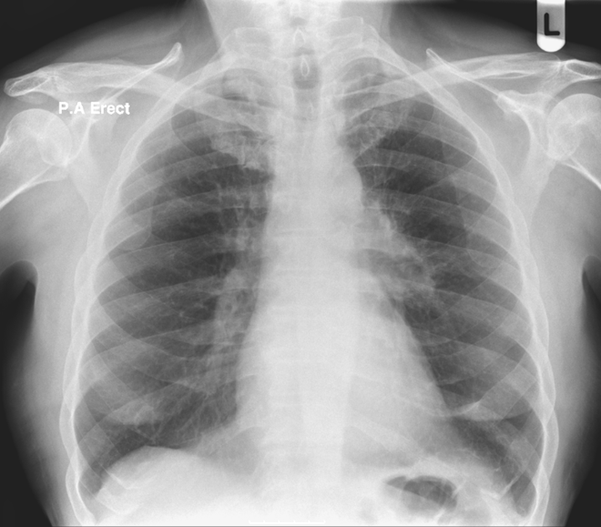
QUIZ # 29 46-year-old female presenting with night sweats and weight loss;
1. What is the main abnormality?
A. Hilum abnormality
B. Lung parenchymal abnormality
C. Pleural abnormality
D. Cardiac outline abnormality
E. Normal appearances
2. What bony abnormalities can you identify?
A. Sclerotic bone lesions
B. Lucent bone lesions
C. Resorption of the distal clavicles
D. Pectus excavatum
E. No abnormality
Notes:
1. A. Hilum abnormality. The left hilum is abnormal in that it is dense and has an abnormal ‘lumpy bumpy’ contour. The differential for asymmetrical lymphadenopathy would include tuberculosis, primary bronchogenic carcinoma, lymphoma and less likely sarcoidosis. Following tissue biopsy this patient was diagnosed with Hodgkin’s lymphoma.
2. E. No abnormality. No bony abnormality is evident on the film but given the suspicious left hilum, special attention should be given to identifying any bony involvement.

Slide 31
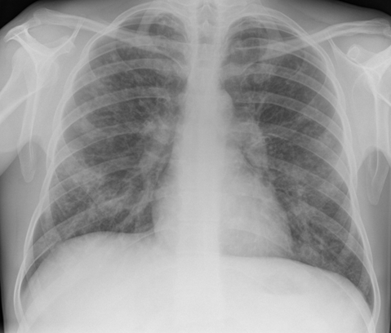
QUIZ # 30
1. What is the main abnormality?
A. Reticulonodular shadowing and bilateral hilar enlargement
B. Tram-tracking and ring shadows with bilateral hilar enlargement
C. Bilateral hilar and bony abnormalities
D. Interstitial shadowing and bilateral enlarged hilar
E. Lung parenchymal, hilar and bony abnormalities
2. What is the most likely underlying diagnosis?
A. Idiopathic pulmonary fibrosis with likely pulmonary hypertension
B. Cystic fibrosis with bronchiectasis
C. Sarcoidosis
D. Lymphangitis carcinomatosis
E. Rheumatoid arthritis
Notes:
1. B. Tram-tracking and ring shadows with bilateral hilar enlargement. This patient has features of bronchiectasis; there is evidence of bronchial dilatation and bronchial wall thickening as noted by the ‘tram tracking’ and ring shadows.
In addition, note the enlarged hila which may be due to enlarged lymph nodes, enlarged pulmonary vessels (pulmonary hypertension) and/or inflammatory changes.
2. B. Cystic fibrosis and bronchiectasis. The most likely underlying diagnosis is cystic fibrosis.

Slide 32
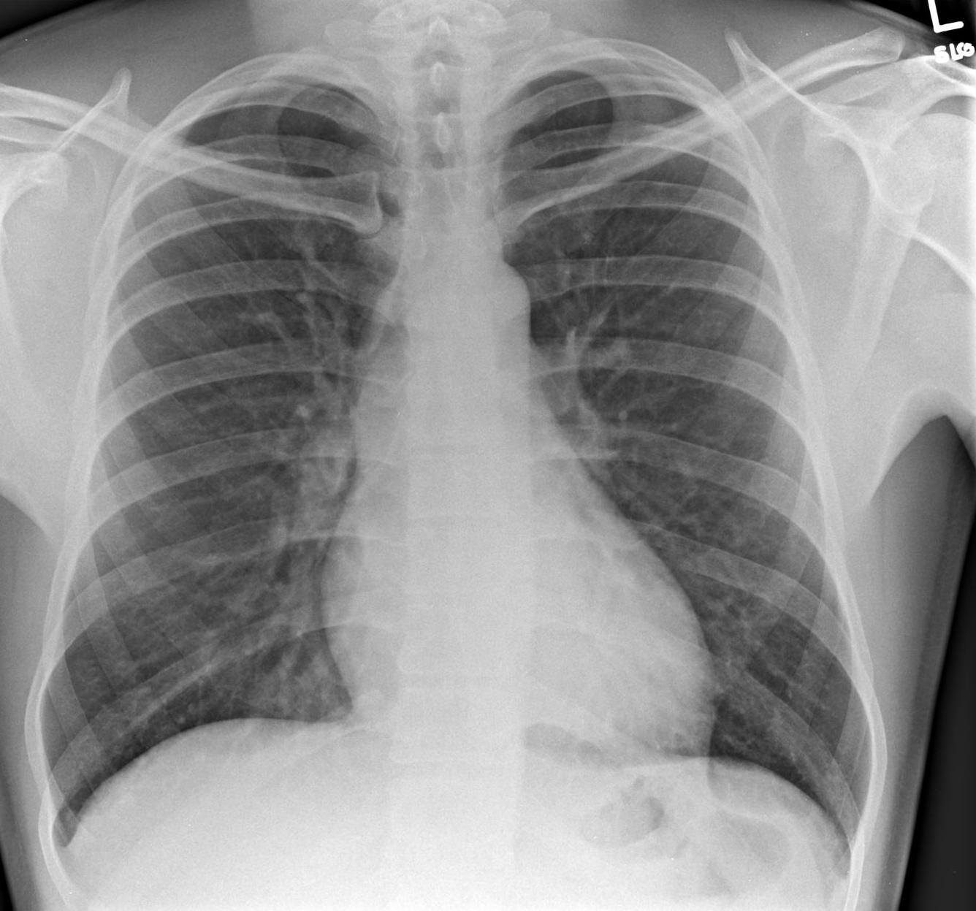
QUIZ # 31 36-year-old male intravenous drug user presenting with leg swelling and chest pain; What is the main abnormality?
A. Pleural abnormality
B. Mediastinal abnormality
C. Bony abnormality
D. Hilar abnormality
E. Normal appearances
Notes:
E. Normal appearances. No significant abnormality on the chest radiograph.

Slide 33
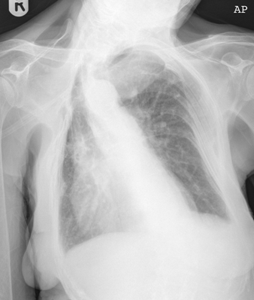
QUIZ # 32 78-year-old female admitted with confusion; What operation has been performed?
A. Right upper lobectomy
B. Plombage
C. Oesophagectomy
D. Thoracoplasty
E. Pleurodesis
Notes:
D. Thoracoplasty
The patient has evidence of a right sided thoracoplasty. This used to be a method of surgical management for tuberculosis when the cavity was located in the apex of the lung. Six to eight ribs would be broken and pushed into the thoracic cavity to collapse the lung beneath.

Slide 34
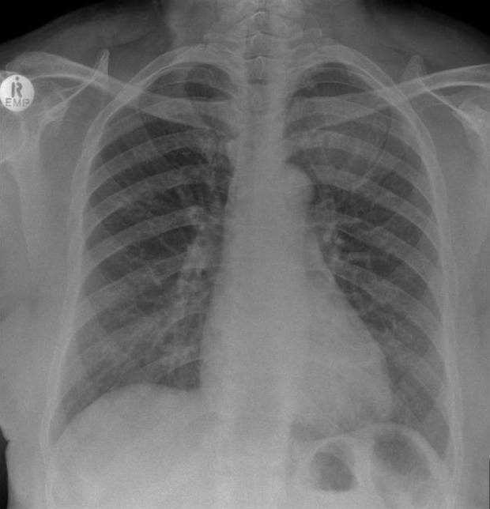
QUIZ # 33 78-year-old male presenting following a fall; Where is the main abnormality?
A. No significant abnormality
B. Lung parenchymal and bony abnormality
C. Lung parenchymal and mediastinal abnormality
D. Bilateral pleural abnormality
E. Mediastinal and bony abnormality
Notes:
1. B. Lung parenchymal and bony abnormality. There is a left upper zone soft tissue mass with associated left first rib destruction which was due to a thyroid carcinoma which had metastasised.

Slide 35
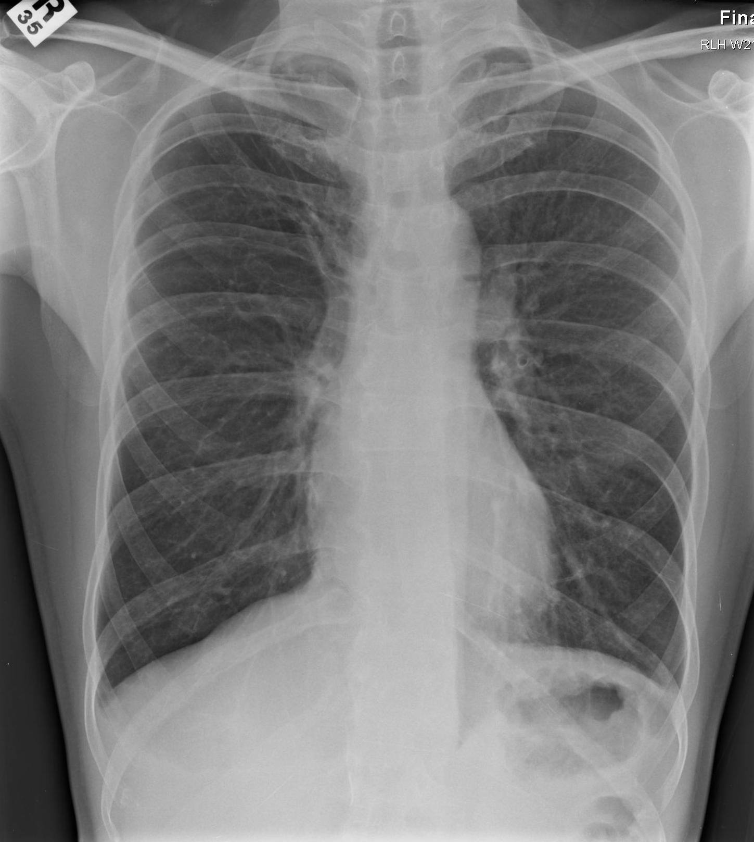
QUIZ # 34 34-year-old male presenting with productive cough and fevers; What is the main abnormality?
A. Lung parenchymal abnormality
B. Bony abnormality
C. Mediastinal abnormality
D. Soft tissue abnormality
E. Normal appearances
Notes:
E. Normal appearances. There is no significant abnormality. This patient was diagnosed with sinusitis and post nasal drip accounting for the cough.

Slide 36
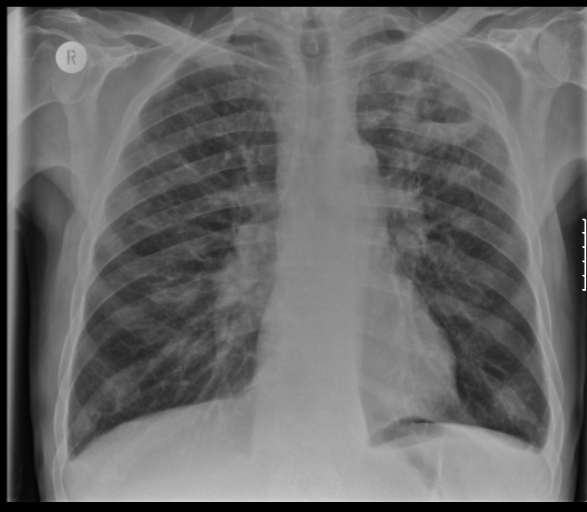
QUIZ # 35 41-year-old male smoker presenting with haemoptysis and weight loss; What is the main abnormality of clinical concern?
A. Lung parenchymal and bony abnormality
B. Lung parenchymal and hilar abnormality
C. Lung parenchymal and pleural abnormality
D. Lung parenchymal and tracheal abnormality
E. Lung parenchymal abnormality
Notes:
B. Lung parenchymal and hilar abnormality There is a thick-walled cavity in the left upper zone with an air-fluid level. There is also bilateral hilar lymphadenopathy and a small left pleural effusion.
The differential diagnosis for these appearances would include a primary bronchogenic neoplasm, tuberculosis and other granulomatous conditions (e.g. Wegener’s granulomatosis). In this case the patient had a squamous cell carcinoma with associated mediastinal lymphadenopathy as well as adrenal and liver metastases.

Slide 37
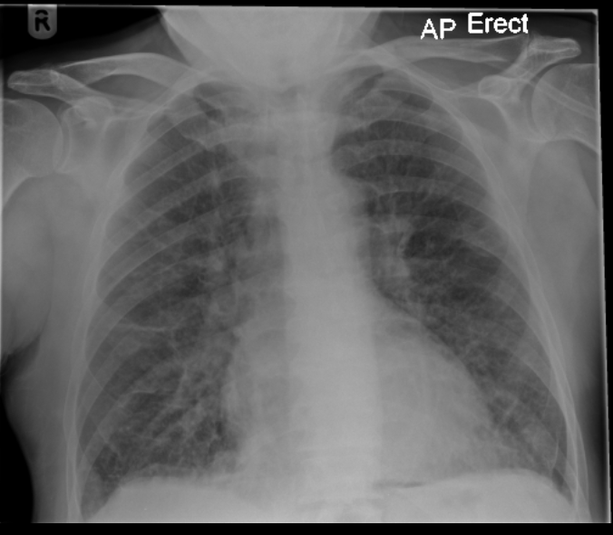
QUIZ # 36 58-year-old male presenting with shortness of breath at rest and cough productive of pink frothy sputum. Where is the main abnormality?
A. Mediastinal abnormality
B. Bony abnormality
C. Hilar abnormality
D. Lung interstitial abnormality
E. Soft tissue abnormality
Notes:
D - Lung interstitial abnormality. There are multiple septal lines bilaterally in keeping with interstitial pulmonary oedema. Note also the fluid in the horizontal fissure.

Slide 38
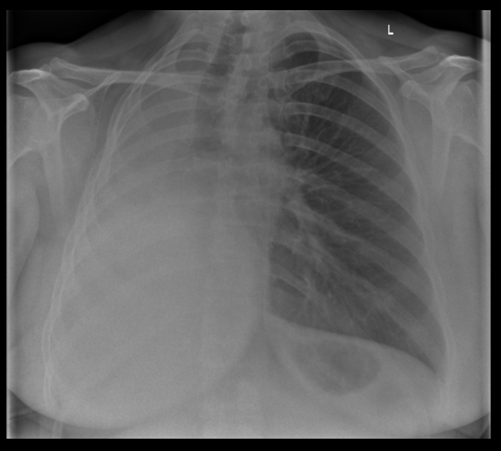
QUIZ # 37 38-year-old female with ongoing shortness of breath; What is the most likely underlying aetiology?
A. Consolidation
B. Iatrogenic
C. Obstructing neoplasm
D. Large pleural effusion
E. Pulmonary fibrosis
Notes:
B. Iatrogenic. There is a ‘white-out’ of the right hemithorax with evidence of volume loss with tracheal and mediastinal deviation to the ipsilateral side. The differential would include total lung collapse or previous pneumonectomy.

Slide 39
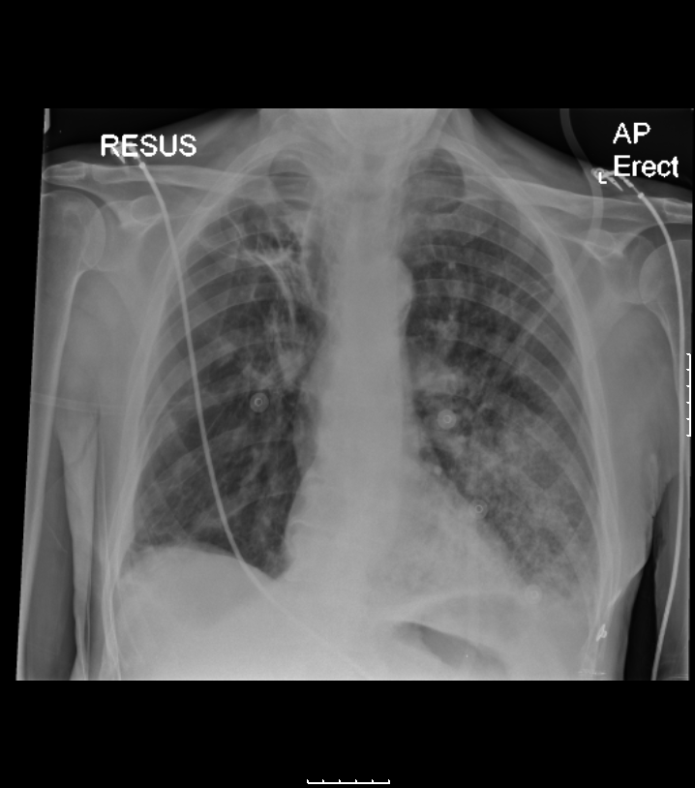
QUIZ # 38 44-year-old male presenting with shortness of breath and cough;
1. What does the patient have in their past medical history?
A. previous varicella pneumonia
B. tuberculosis
C. ankylosing spondylitis
D. histoplasmosis
E. cardiac failure
2. What is the most likely explanation for the acute presentation?
A. Pneumothorax
B. Cardiogenic pulmonary oedema
C. Lobar collapse
D. Pulmonary fibrosis
E. Consolidation
Notes:
1.B. tuberculosis. There is evidence of fibrosis and cavitation within the right upper lobe. Note the volume loss in the right upper lobe with elevation of the right hilum and tracheal deviation. The patient had a history of tuberculosis infection which would account for these findings.
2. E. consolidation. The cause for the patients’ current symptoms is the development of new patchy airspace shadowing in the left lower lobe likely secondary to an infective process. Note how the left hemidiaphragm and costophrenic angle are indistinct when compared to the right side.

Slide 40
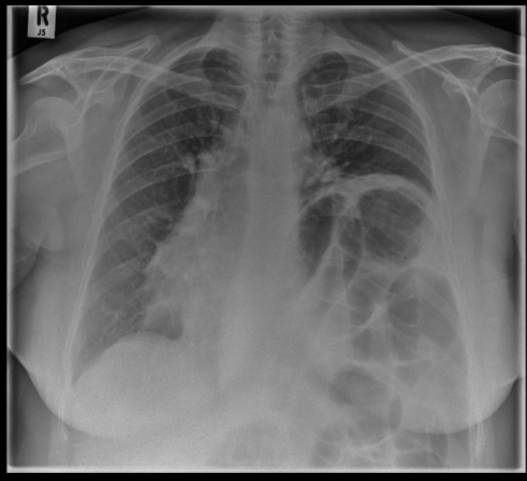
QUIZ # 39 65-year-old female with a history of previous tuberculous infection and presenting with dry cough; What is the most likely explanation for these appearances given the clinical history?
A. post-traumatic
B. neuromuscular disorder
C. phrenic nerve crush
D. malignancy
E. post-inflammatory
Notes:
1.C - Phrenic nerve crush.
There is a markedly elevated left hemi-diaphragm. The patient had previously undergone a phrenicotomy/phrenic nerve crush which was a method of treatment for tuberculosis in the past. The aim was to diminish respiratory movements as well as reduce the total lung volume on the affected side.
Phrenic nerve palsy can be due to lesions anywhere along its course from the neck to the diaphragm. Aetiologies include underlying malignancy (primary or metastatic within the neck/thorax), post-traumatic and iatrogenic, inflammatory processes and various neuromuscular diseases.

Slide 41
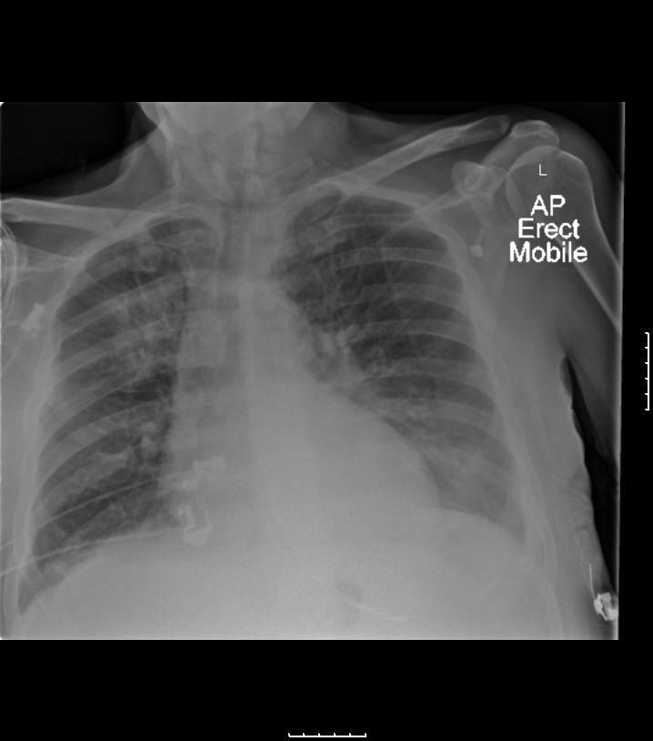
QUIZ # 40 77-year-old male admitted with left sided cerebrovascular accident/stroke. The patient subsequently developed high inflammatory markers and hypoxia;
1. What is the main abnormality?
A. Consolidation
B. Pleural fluid collections
C. Pneumothorax
D. Atelectasis
E. Normal appearances
2. Is the nasogastric tube appropriately positioned?
A. Yes
B. No
Notes:
1. A. Consolidation. The patient has consolidation within the right upper zone with evidence of air bronchograms (yellow arrows). Air bronchograms become apparent when the tubular outline of a bronchus becomes visible within a thoracic opacity. This most commonly occurs with pneumonia where the alveoli become filled with pus.
In this case, give the history of a stroke, aspiration pneumonia is the likely cause.
2. A. Yes - The nasogastric tube is adequately positioned with its tip projected below the diaphragm.

Slide 42
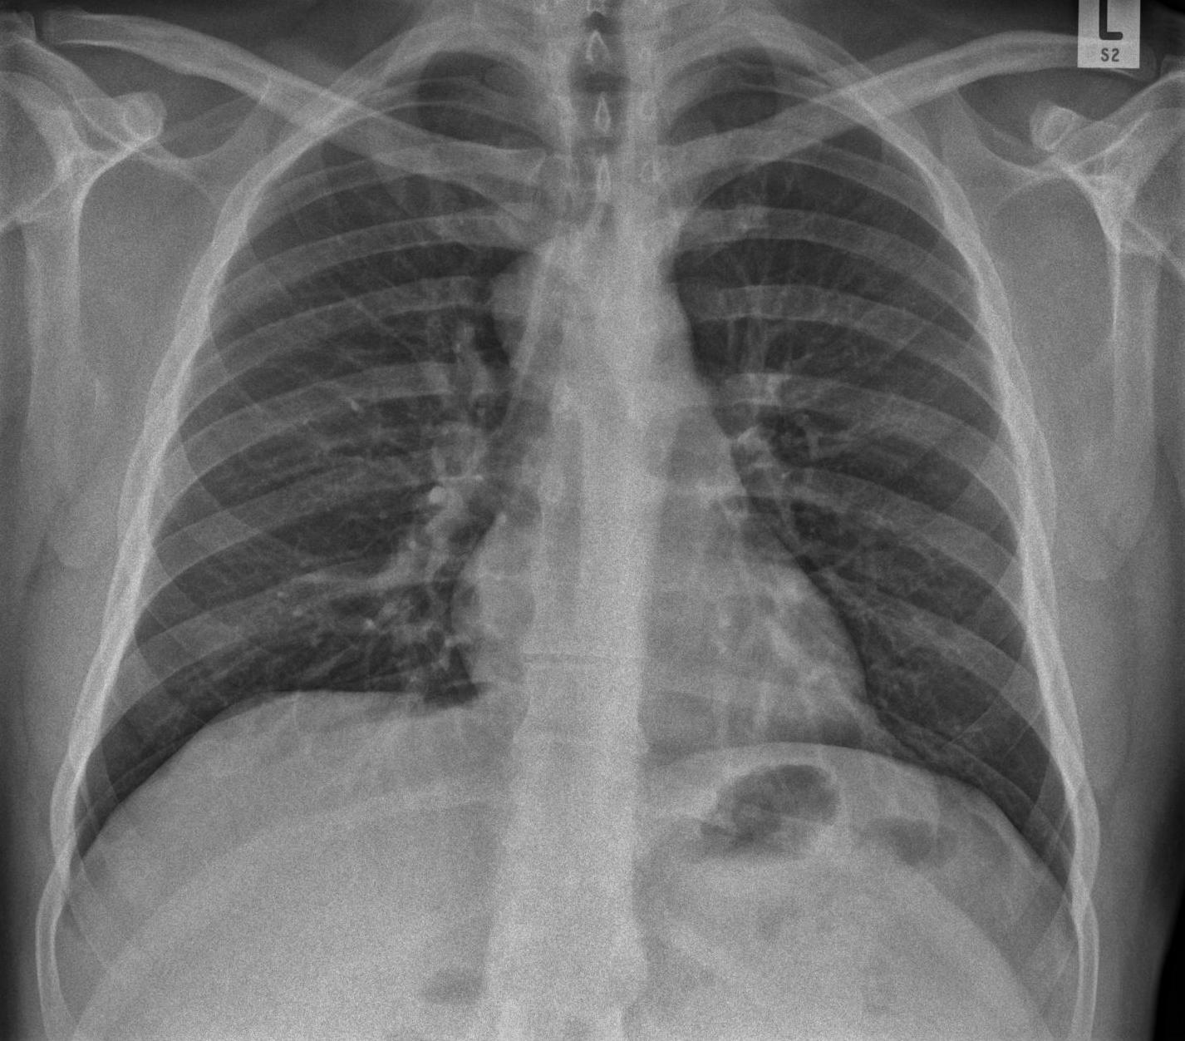
QUIZ # 41 41 year old male with generalised malaise and fevers; What is the main abnormality?
A. Mediastinal abnormality
B. Hilar abnormality
C. Bony abnormality
D. Lung parenchymal abnormality
E. Normal appearances
Notes:
A. Mediastinal abnormality. There is an abnormal soft tissue density projected over the right side of the trachea/carina (yellow arrows) in keeping with an underlying mediastinal mass. On the selected axial image this was located posterolateral to the trachea and contained internal calcification. This was confirmed to be due to a mature teratoma.

Slide 43
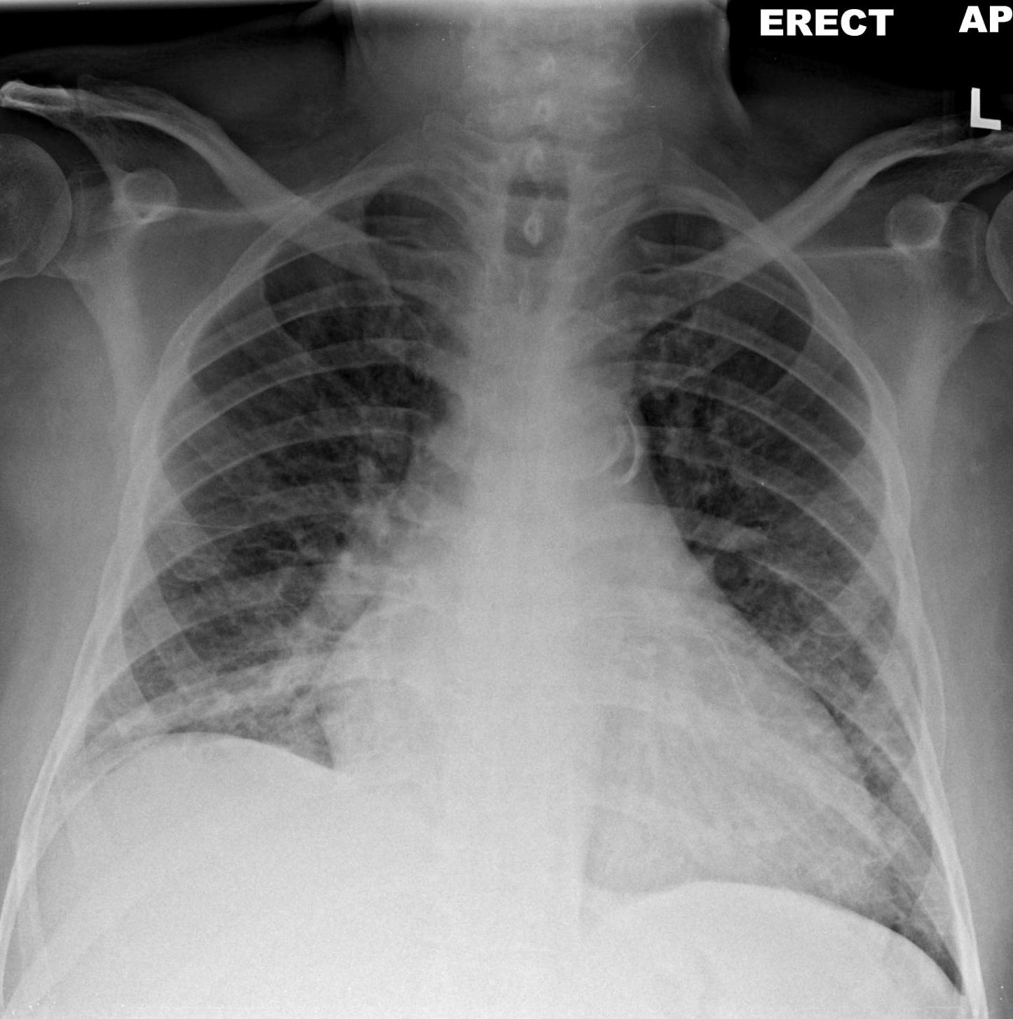
QUIZ # 42 59 year old male with breathlessness at rest; What is the most likely cause for these appearances?
A. Cardiogenic pulmonary oedema
B. Pulmonary fibrosis
C. Lymphangitis carcinomatosis
D. Hypersensitivity pneumonitis
E. Normal appearances
Notes:
A. Cardiogenic pulmonary oedema. There are multiple septal lines (Kerley B lines) noted bilaterally predominantly in both lower zones. The findings are most likely due to pulmonary oedema.
There is also evidence of coronary artery calcification (red arrow) and cardiomegaly which suggests that the pulmonary odema is likely cardiogenic origin and this is most likely secondary to ischaemic heart disease.

Slide 44
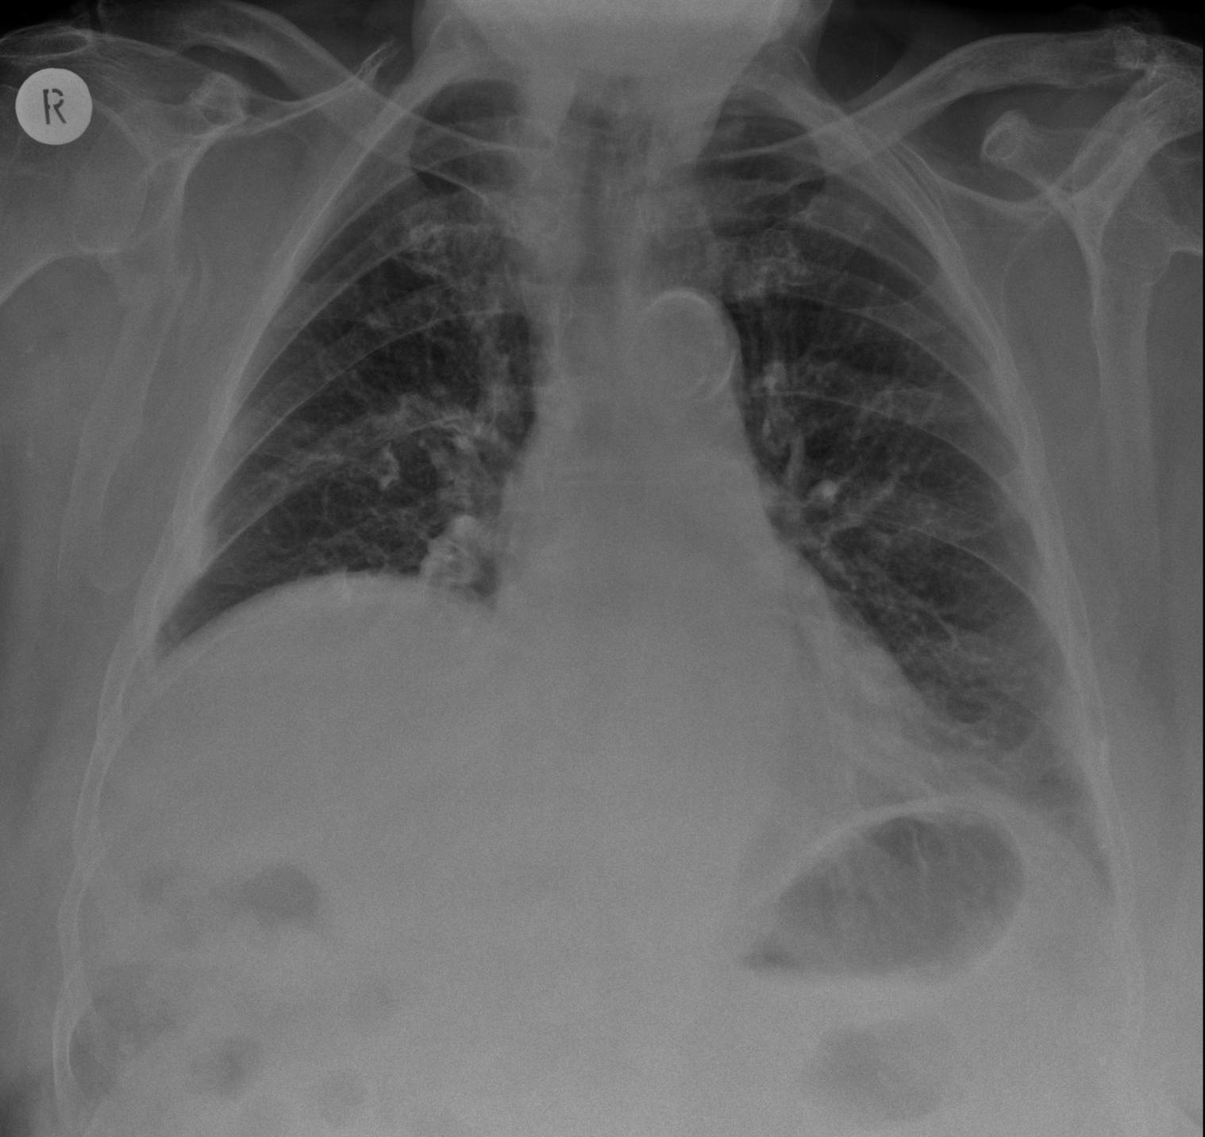
QUIZ # 43 72 year old male admitted with confusion following a fall; What is the main abnormality? The elevated right hemidiaphragm was longstanding.
A. Pleural abnormality B. Mediastinal abnormality C. Bony abnormality D. Lung parenchymal abnormality E. Normal appearances
Notes:
C. Bony abnormality. There is an acute fracture of the right scapular blade.
[The position of the right hemidiaphragm was unchanged when compared to a previous chest radiograph taken 4 years previously]

Slide 45
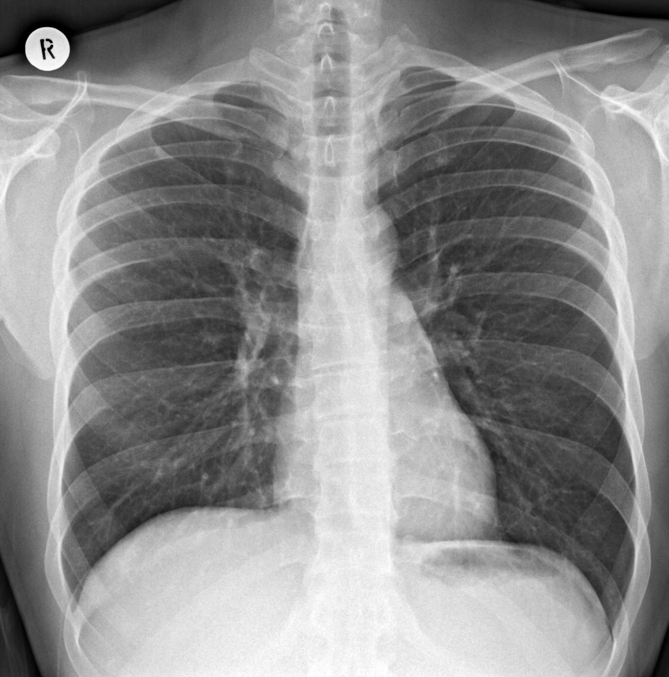
QUIZ # 44 40 year old male with productive cough and breathlessness; What is the main abnormality?
A. Lung parenchymal abnormality B. Mediastinal abnormality C. Bony abnormality D. Pulmonary vasculature abnormality E. Normal appearances
Notes:
E. Normal appearances. No significant abnormality on the chest radiograph.

Slide 46
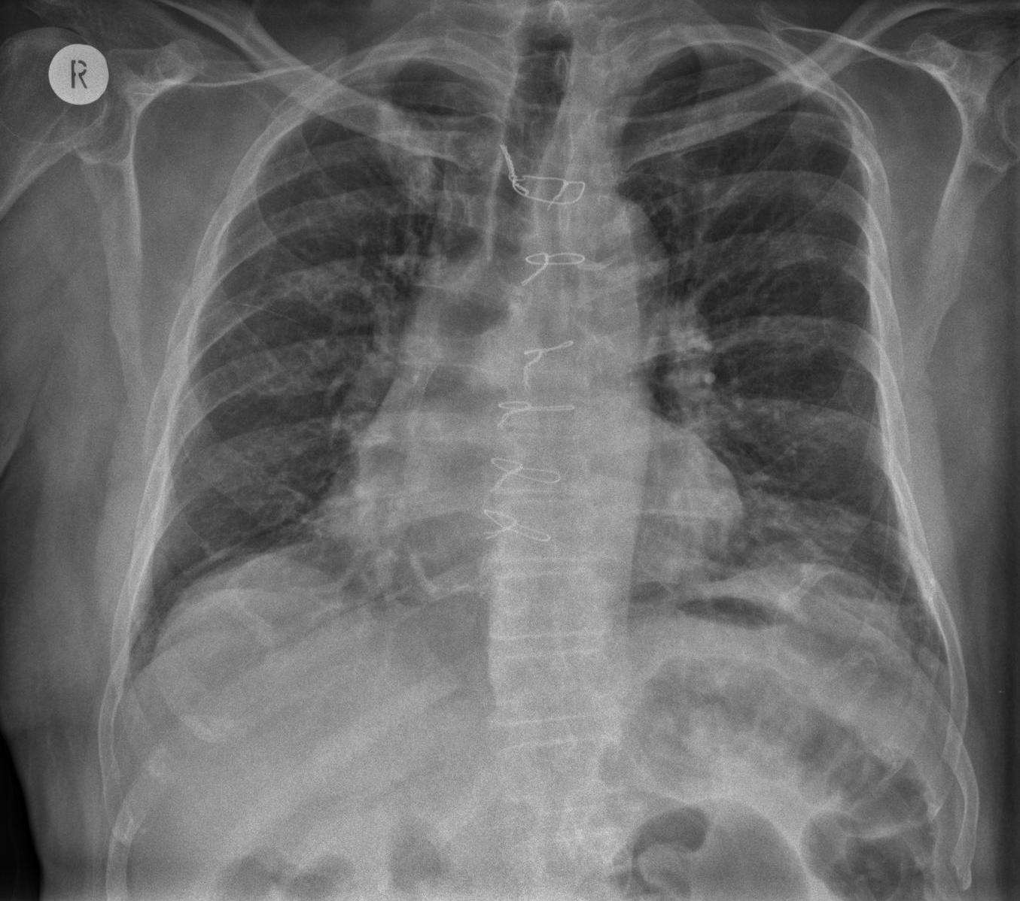
QUIZ # 45 61 year old male smoker with a history of ischaemic heart disease and previous coronary artery bypass grafting. The patient presented with breathlessness; What is the main abnormality?
A. Cardiomegaly B. Normal appearances C. Mediastinal abnormality D. Diaphragmatic abnormality E. Soft tissue mass
Notes:
E. Soft tissue mass. There is a soft tissue opacity projected behind the right 1st rib (yellow arrow). This was confirmed to be a squamous cell carcinoma on subsequent tissue biopsy.
The differential for a solitary pulmonary lesion would include;
NEOPLASMS
> MALIGNANT
- Primary bronchogenic carcinoma
- Metastases
> BENIGN
- Hamartoma
GRANULOMA
- Tuberculosis
- Histoplasmosis
VASCULAR
- Arteriovenous malformations
- Haematoma

Slide 47
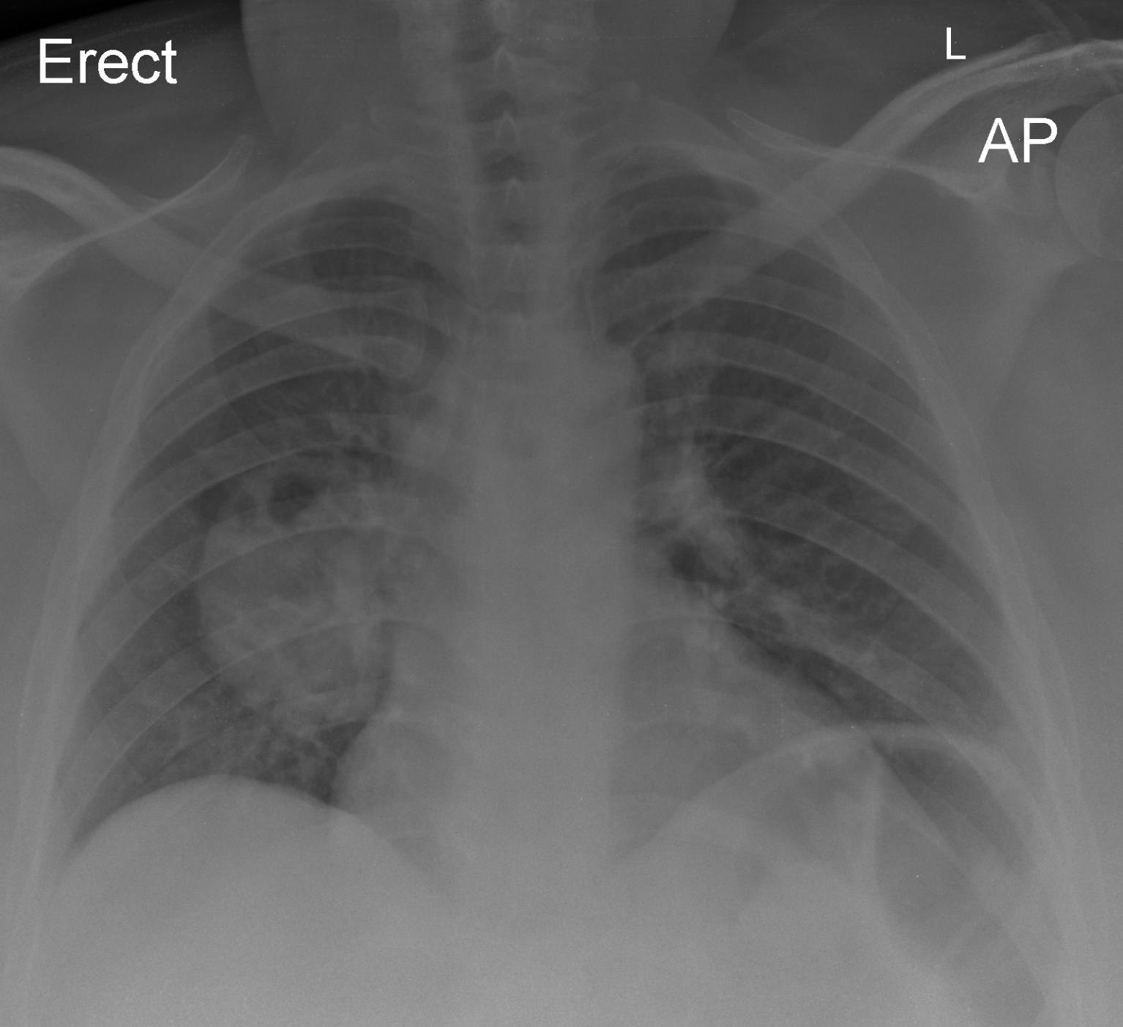
QUIZ # 46 37 year old male non smoker admitted with fevers and productive cough. The patient has a longstanding congenital abnormality; What is the most likely diagnosis?
A. Infected congenital cystic adenomatoid malformation B. Congenital diaphragmatic hernia C. Infected bronchogenic cyst D. Bronchial atresia E. Primitive neuroectodermal tumour
Notes:
C. Infected bronchogenic cyst. There is a well defined rounded soft tissue density within the right mid zone with evidence of internal gas (refer to axial CT image below);
The patient had a longstanding bronchogenic cyst which has subsequently become infected. Bronchogenic cysts are uncommon lesions that result from abnormal budding of the ventral foregut. They are usually located in the hilar or mediastinal region are cystic structures lined be respiratory epithelium. Other potential complications of bronchogenic cysts include local compression on surrounding structures (e.g. oesophagus, blood vessels and airways) as well as internal haemorrhage.

Slide 48
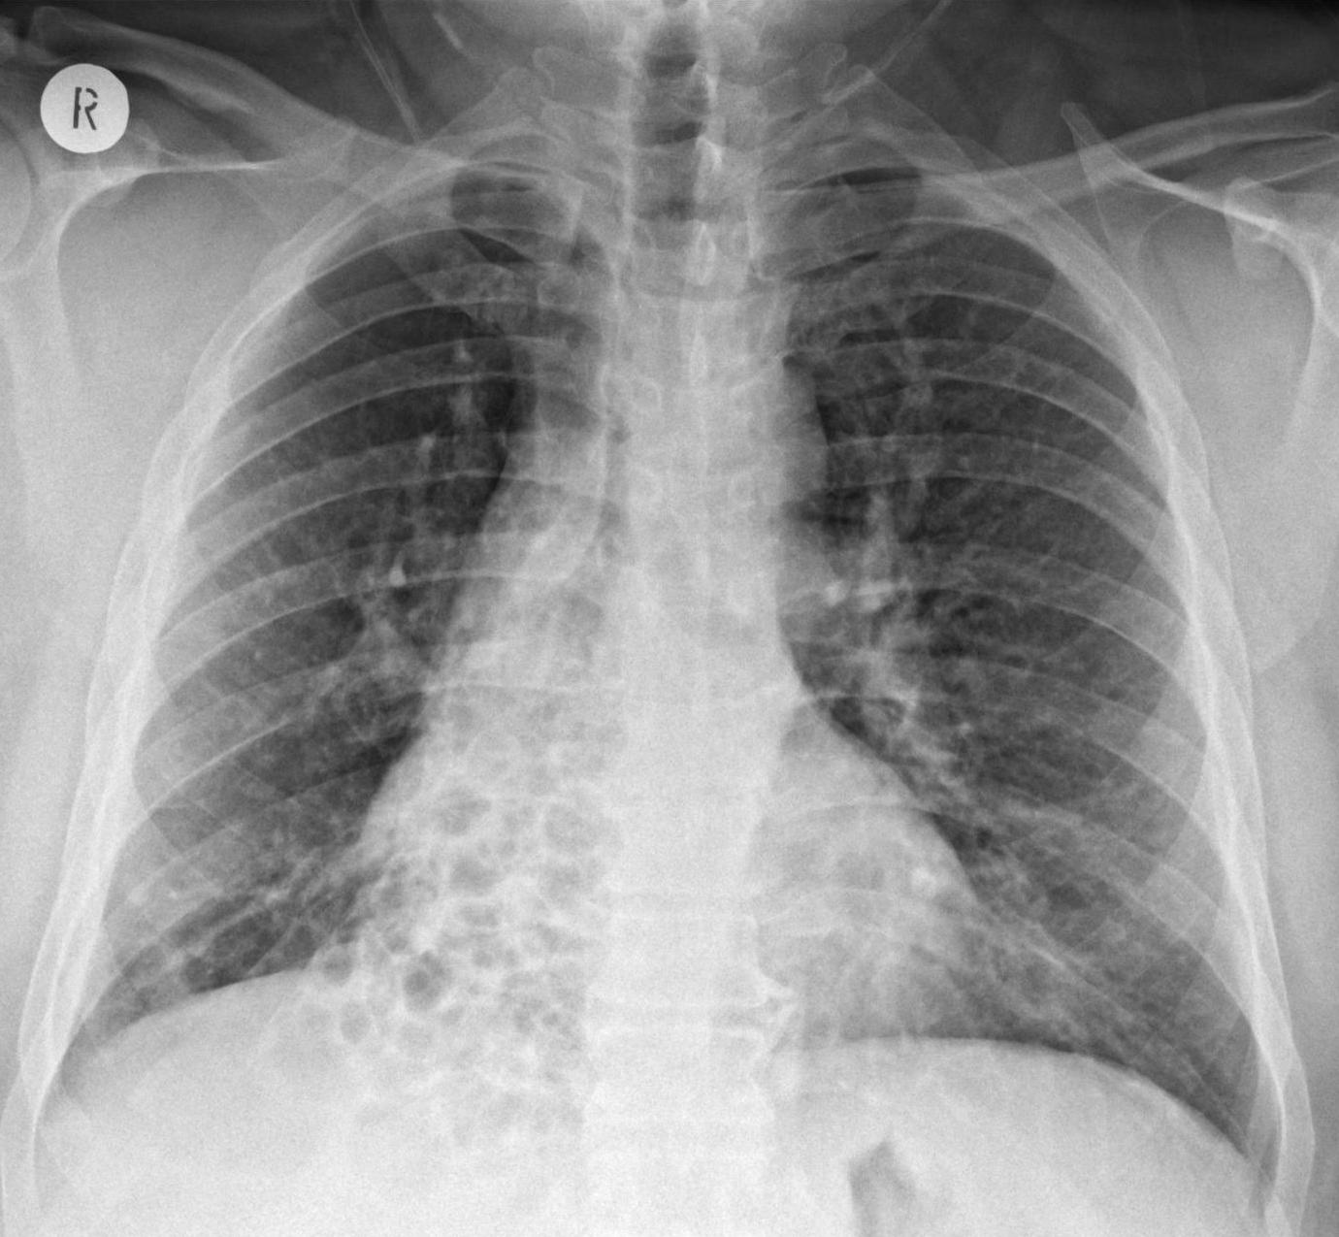
QUIZ # 47 43 year old male with history of chronic productive cough; What is the main abnormality?
A. Reticulonodular shadowing B. Cystic structures C. Mediastinal abnormality D. Lobar collapse E. Normal appearances
Notes:
B. Cystic structures. There is evidence of cystic bronchiectasis within the right lower lobe which was confirmed on a subsequent CT scan (selected axial image below). In this patient the bronchiectasis was secondary to a severe childhood infection.
Aetiology for bronchiectasis includes;
POST-INFECTIVE
- Staphylococcus aureus, Klebsiella species, Mycoplasma pneumoniae
- Mycobacterium tuberculosis,, nontuberculous mycobacteria
measles, pertussis, influenza, herpes simplex, respiratory syncytial virus
POST-OBSTRUCTIVE
- endobronchial tumors, broncholithiasis, foreign bodies
IMPAIRED CLEARANCE OF SECRETIONS
- Cystic fibrosis, Young syndrome, Kartageners syndrome
IMMUNODEFICIENCY
- Congenital; humoral and cell mediated Acquired; HIV
OTHER
- Allergic bronchopulmonary aspergillosis, Traction bronchiectasis secondary to underlying lung fibrosis

Slide 49
QUIZ # 48
A.

